Slide 1
Assignment-07
1. MIMO linear processing
MIMO without CSIT
2)RxMF
3)RxZF
4)RxMMSE
MIMO with CSIT
5) Joint SVD
6)Numerical result

Slide 2
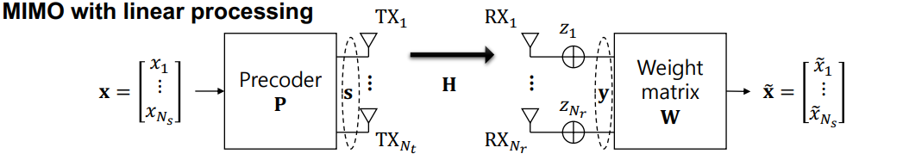
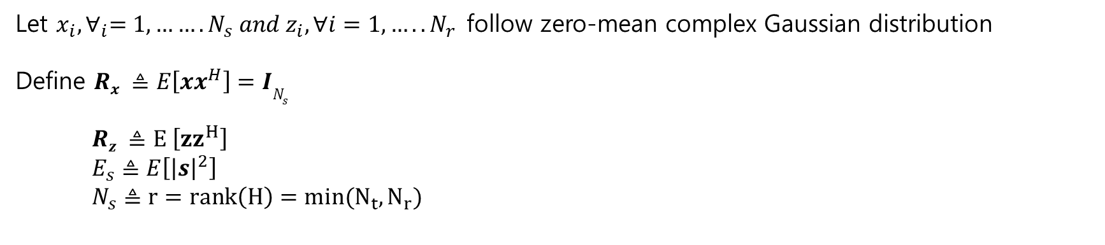
MIMO with linear processing
Let $x_{i}, ∀_{i}=1,…….N_{s} and z_{i}, ∀i=1,…..N_{r}$follow zero-mean complex Gaussian distribution
Define $Rx ≜E\left[xx^{H}\right]=IN_{s}$
$Rz ≜E \left[{zz}^{H}\right]$
$E_{s}≜E\left[{\left|s\right|}^{2}\right]$
$N_{s}≜r=rank\left(H\right)=min(N_{t},N_{r})$

Slide 3
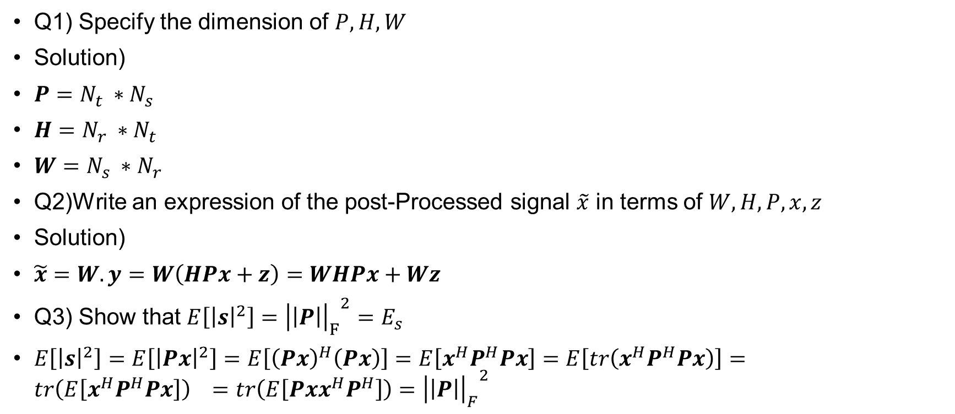
MIMO with linear processing
Q1) Specify the dimension of $P, H, W$
Solution)
$P=N_{t} ∗N_{s}$
$H=N_{r} ∗N_{t}$
$W=N_{s} ∗N_{r}$
Q2)Write an expression of the post-Processed signal $\tilde{x}$ in terms of $W,H,P,x,z$
Solution)
$\tilde{x}=W.y=W\left(HPx+z\right)=WHPx+Wz$
Q3) Show that $E\left[{\left|s\right|}^{2}\right]={{\left|\left|P\right|\right|}_{F}}^{2}=E_{s}$
$E\left[{\left|s\right|}^{2}\right]=E\left[{\left|Px\right|}^{2}\right]=E\left[{\left(Px\right)}^{H}\left(Px\right)\right]=E\left[x^{H}P^{H}Px\right]=E\left[tr\left(x^{H}P^{H}Px\right)\right]=tr\left(E\left[x^{H}P^{H}Px\right]\right) =tr\left(E\left[Pxx^{H}P^{H}\right]\right)={{\left|\left|P\right|\right|}_{F}}^{2}$

Slide 4
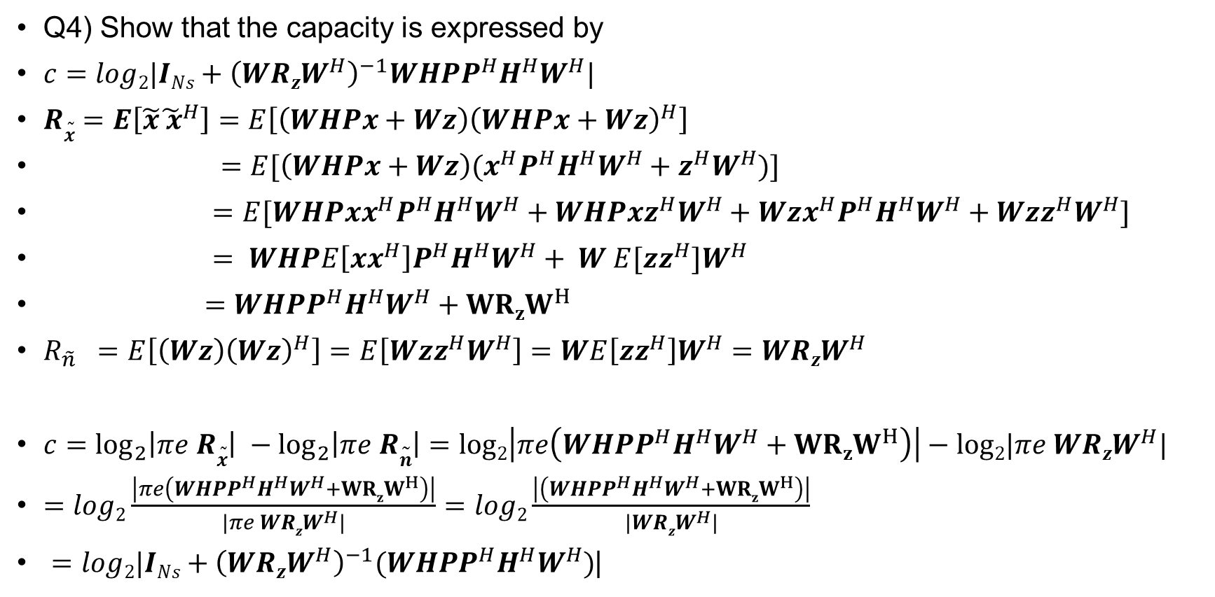
MIMO with linear processing
Q4) Show that the capacity is expressed by
$c=log2|INs+{\left(WRzW^{H}\right)}^{−1}WHPP^{H}H^{H}W^{H}|$
$R\tilde{x}=E\left[\tilde{x}{\tilde{ x}}^{H}\right]=E\left[\left(WHPx+Wz\right){\left(WHPx+Wz\right)}^{H}\right]$
$=E[\left(WHPx+Wz\right)(x^{H}P^{H}H^{H}W^{H}+z^{H}W^{H})]$
$=E[WHPxx^{H}P^{H}H^{H}W^{H}+WHPxz^{H}W^{H}+Wzx^{H}P^{H}H^{H}W^{H}+Wzz^{H}W^{H}]$
$= WHPE\left[xx^{H}\right]P^{H}H^{H}W^{H}+ W E[zz^{H}]W^{H}$
$=WHPP^{H}H^{H}W^{H}+{WRzW}^{H}$
$R_{\tilde{n}} =E\left[\left(Wz\right){\left(Wz\right)}^{H}\right]=E\left[Wzz^{H}W^{H}\right]=WE\left[zz^{H}\right]W^{H}=WRzW^{H}$
$c=\log_{2}\left|πe R\tilde{x}\right| −\log_{2}\left|πe R\tilde{n}\right|=log2\left|πe\left(WHPP^{H}H^{H}W^{H}+{WRzW}^{H}\right)\right|−log2|πe WRzW^{H}|$
$=log2\frac{\left|πe\left({WHPP}^{H}H^{H}W^{H}+{WRzW}^{H}\right)\right|}{|πe WRzW^{H}|}=log2\frac{\left|\left(WHPP^{H}H^{H}W^{H}+{WRzW}^{H}\right)\right|}{|WRzW^{H}|}$
$=log2|INs+{\left(WRzW^{H}\right)}^{−1}(WHPP^{H}H^{H}W^{H})$|

Slide 5
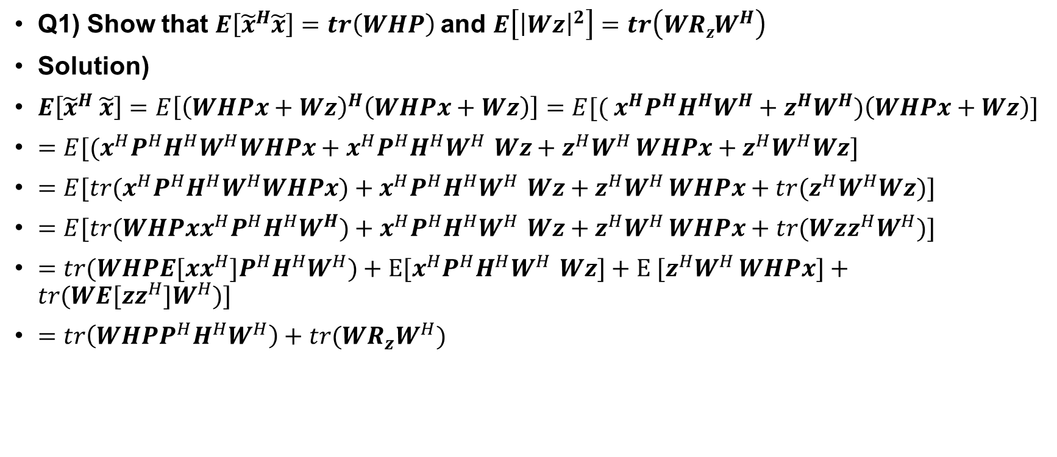
MIMO without CSIT – RxMF
Q1) Show that $E\left[{\tilde{x}}^{H}\tilde{x}\right]=tr\left(WHP\right)$and $E\left[{\left|Wz\right|}^{2}\right]=tr\left(WRzW^{H}\right)$
Solution)
$E\left[{\tilde{x}}^{H} \tilde{x}\right]=E\left[{\left(WHPx+Wz\right)}^{H}\left(WHPx+Wz\right)\right]=E[{( x}^{H}P^{H}H^{H}W^{H}+z^{H}W^{H})\left(WHPx+Wz\right)]$
$=E[{(x}^{H}P^{H}H^{H}W^{H}WHPx+x^{H}P^{H}H^{H}W^{H }Wz+z^{H}W^{H }WHPx+z^{H}W^{H}Wz]$
$=E[tr{(x}^{H}P^{H}H^{H}W^{H}WHPx)+x^{H}P^{H}H^{H}W^{H }Wz+z^{H}W^{H }WHPx+{tr(z}^{H}W^{H}Wz)]$
$=E[tr(WHPxx^{H}P^{H}H^{H}W^{H})+x^{H}P^{H}H^{H}W^{H }Wz+z^{H}W^{H }WHPx+tr(Wzz^{H}W^{H})]$
$=tr(WHPE[xx^{H}]P^{H}H^{H}W^{H})+E[x^{H}P^{H}H^{H}W^{H }Wz]+{E [z}^{H}W^{H }WHPx]+tr(WE[zz^{H}]W^{H})]$
$=tr\left(WHPP^{H}H^{H}W^{H}\right)+tr(WR_{z}W^{H})$

Slide 6
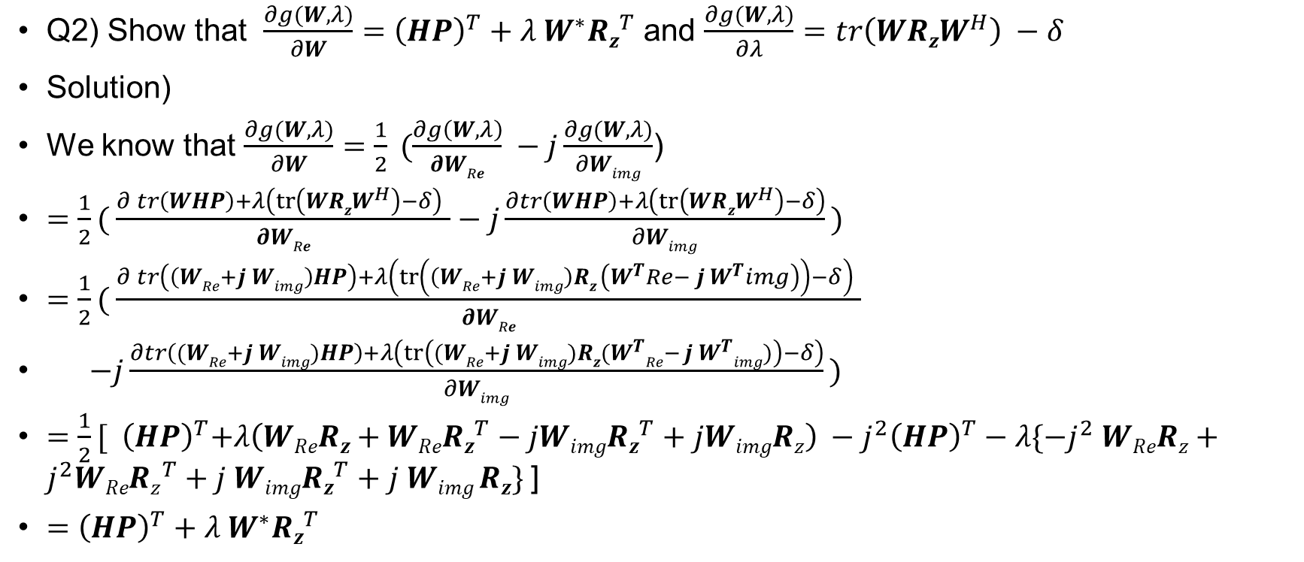
MIMO without CSIT – RxMF
Q2) Show that $\frac{∂g(W,λ)}{∂W}={\left(HP\right)}^{T}+λ{ W}^{∗}Rz^{T}$ and $\frac{∂g(W,λ)}{∂λ}=tr\left(WRzW^{H}\right) −δ$
Solution)
We know that $\frac{∂g(W,λ)}{∂W}=\frac{1}{2} (\frac{∂g\left(W,λ\right)}{∂WRe} −j\frac{∂g(W,λ)}{∂Wimg}$)
$=\frac{1}{2}( \frac{∂ tr\left(WHP\right)+λ\left(tr\left(WRzW^{H}\right)−δ\right) }{∂WRe}−j\frac{∂tr\left(WHP\right)+λ\left(tr\left(WRzW^{H}\right)−δ\right)}{∂Wimg} )$
$=\frac{1}{2}( \frac{∂ tr\left(\left(WRe+j Wimg\right)HP\right)+λ\left(tr\left(\left(WRe+j Wimg\right)Rz \left(W^{T}Re− j W^{T}img\right)\right)−δ\right) }{∂WRe}$
$−j\frac{∂tr\left((WRe+j Wimg)HP\right)+λ\left(tr\left((WRe+j Wimg)Rz(W^{T}Re− j W^{T}img)\right)−δ\right)}{∂Wimg} )$
$=\frac{1}{2}[{ \left(HP\right)}^{T}+λ\left(WReRz+WReRz^{T}−jWimgRz^{T}+jWimgRz\right) −j^{2}{\left(HP\right)}^{T}−λ\{−j^{2} WReRz+j^{2}WReRz^{T}+j Wimg{Rz}^{T}+j Wimg Rz\}$]
$={\left(HP\right)}^{T}+λ{ W}^{∗}Rz^{T}$

Slide 7
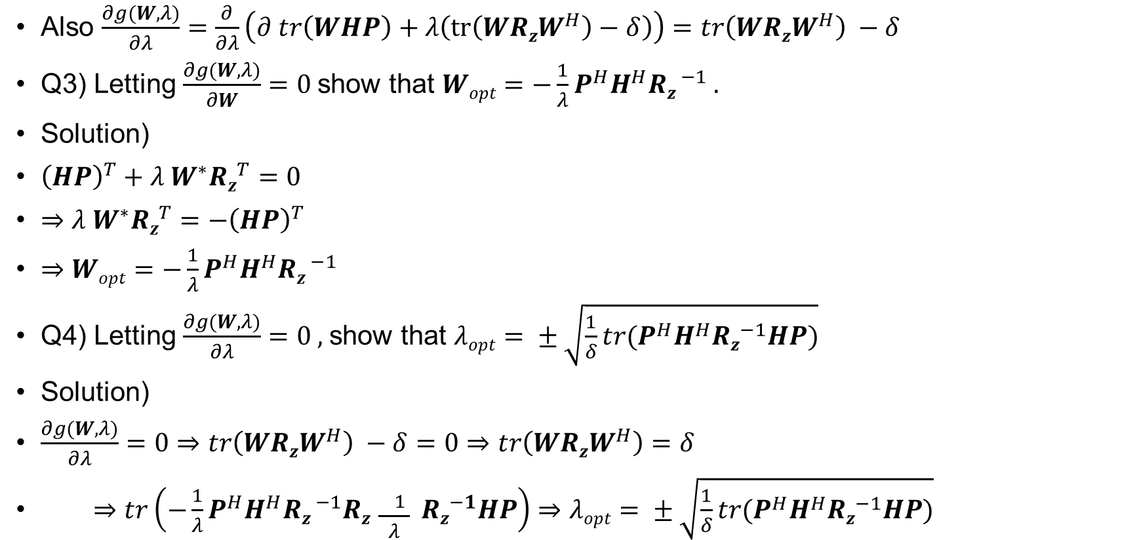
MIMO without CSIT – RxMF
Also $\frac{∂g(W,λ)}{∂λ}=\frac{∂}{∂λ}\left(∂ tr\left(WHP\right)+λ\left(tr\left(WRzW^{H}\right)−δ\right)\right)=tr\left(WRzW^{H}\right) −δ$
Q3) Letting $\frac{∂g(W,λ)}{∂W}=0$show that $Wopt=−\frac{1}{λ}P^{H}H^{H}Rz^{ −1} .$
Solution)
${\left(HP\right)}^{T}+λ{ W}^{∗}Rz^{T}=0$
$⇒λ{ W}^{∗}Rz^{T}=−{\left(HP\right)}^{T}$
$⇒Wopt=−\frac{1}{λ}P^{H}H^{H}Rz^{ −1}$
Q4) Letting $\frac{∂g(W,λ)}{∂λ}=0 ,$show that $λopt= ± \sqrt{\frac{1}{δ}tr(P^{H}H^{H}Rz^{−1}HP)}$
Solution)
$\frac{∂g(W,λ)}{∂λ}=0⇒tr\left(WRzW^{H}\right) −δ=0⇒tr\left(WRzW^{H}\right)=δ$
$⇒tr\left(−\frac{1}{λ}P^{H}H^{H}Rz^{ −1}Rz \frac{− 1 }{λ} Rz^{−1}HP\right)⇒λopt= ± \sqrt{\frac{1}{δ}tr(P^{H}H^{H}Rz^{−1}HP)}$

Slide 8
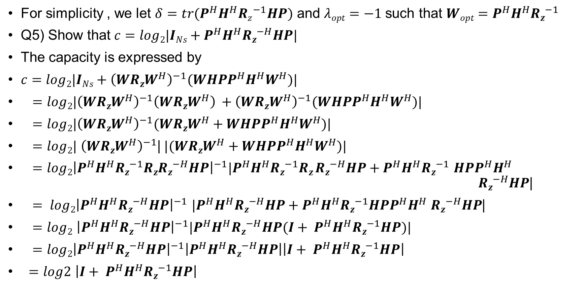
MIMO without CSIT – RxMF
For simplicity , we let $δ=tr(P^{H}H^{H}Rz^{−1}HP)$ and $λopt=−1$such that $Wopt=P^{H}H^{H}Rz^{−1}$
Q5) Show that $c=log2|INs+P^{H}H^{H}Rz^{−H}HP|$
The capacity is expressed by
$c=log2|INs+{\left(WRzW^{H}\right)}^{−1}(WHPP^{H}H^{H}W^{H})\text{|}$
$=log2|{\left(WRzW^{H}\right)}^{−1}{\left(WRzW^{H}\right)}^{ }+{\left(WRzW^{H}\right)}^{−1}(WHPP^{H}H^{H}W^{H})|$
$=log2|{\left(WRzW^{H}\right)}^{−1}(WRzW^{H}+WHPP^{H}H^{H}W^{H})|$
$=log2|$ ${\left(WRzW^{H}\right)}^{−1}$|$|(WRzW^{H}+WHPP^{H}H^{H}W^{H})|$
$=log2{\left|P^{H}H^{H}Rz^{−1}RzRz^{−H}HP\right|}^{−1}|P^{H}H^{H}Rz^{−1}Rz Rz^{−H}HP+P^{H}H^{H}Rz^{−1}$ $HPP^{H}H^{H}$ $Rz^{−H}HP$|
$= log2{\left|P^{H}H^{H}Rz^{−H}HP\right|}^{−1}$ $|P^{H}H^{H}Rz^{−H}HP+P^{H}H^{H}Rz^{−1}HPP^{H}H^{H}$ $Rz^{−H}HP$|
$=log2$ ${\left|P^{H}H^{H}Rz^{−H}HP\right|}^{−1}|P^{H}H^{H}Rz^{−H}HP(I+ P^{H}H^{H}Rz^{−1}HP)|$
$=log2{\left|P^{H}H^{H}Rz^{−H}HP\right|}^{−1}\left|P^{H}H^{H}Rz^{−H}HP\right|\left|I+ P^{H}H^{H}Rz^{−1}HP\right|$
$=log2$ $\left|I+ P^{H}H^{H}Rz^{−1}HP\right|$

Slide 9

MIMO without CSIT – RxMF
Q6)For AWGN , i.e $R_{z}=σ{z }^{2} INr.$
Show that $c=log2 |I_{N_{s}}+\frac{1}{σ^{2 }z} P^{H}H^{H}HP|$
Solution)
$c=log_{2}$ $\left|INS+ P^{H}H^{H}Rz^{−1}HP\right|$
$=log_{2}|INS+P^{H}H^{H}\frac{1}{σ^{2 }z}HP|$

Slide 10
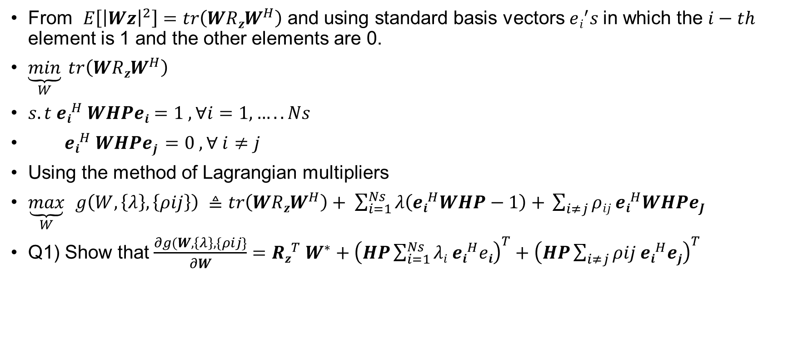
MIMO without CSIT – RxZF
From $E\left[{\left|Wz\right|}^{2}\right]=tr\left(WRzW^{H}\right)$ and using standard basis vectors $ei^{′}s$in which the $i−th$ element is 1 and the other elements are 0.
$\underset{W}{\underbrace{min}} tr\left(WRzW^{H}\right)$
$s.t ei^{H} WHPei=1 , ∀i=1,…..Ns$
$ei^{H} WHPej =0 , ∀ i≠j$
Using the method of Lagrangian multipliers
$\underset{W}{\underbrace{max}}$ $g\left(W,\left\{λ\right\},\left\{ρij\right\}\right) ≜tr\left(WRzW^{H}\right)+ \sum_{i=1}^{Ns}{λ\left(ei^{H}WHP−1\right)+ }\sum_{i≠j}{ρij ei^{H}WHPeJ}$
Q1) Show that $\frac{∂g(W,\left\{λ\right\},\{ρij\}}{∂W}=Rz^{T} W^{∗}+{\left(HP\sum_{i=1}^{Ns}{λi ei^{H}ei}\right)}^{T}+{\left(HP\sum_{i≠j}{ρij ei^{H}ej}\right)}^{T}$

Slide 11
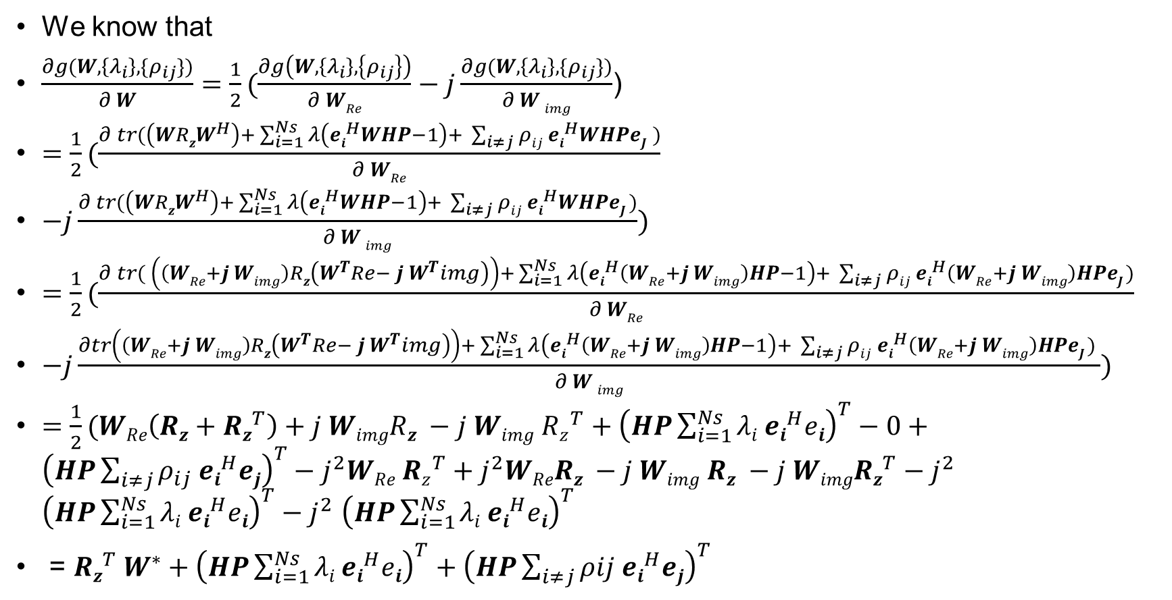
MIMO without CSIT – RxZF
We know that
$\frac{∂g(W,\left\{λ_{i}\right\},\{ρ_{ij}\})}{∂ W}=\frac{1}{2}(\frac{∂g\left(W,\left\{λ_{i}\right\},\left\{ρ_{ij}\right\}\right)}{∂ WRe}−j\frac{∂g(W,\left\{λ_{i}\right\},\{ρ_{ij}\})}{∂ W img}$)
$=\frac{1}{2}(\frac{∂ tr(\left(WRzW^{H}\right)+ \sum_{i=1}^{Ns}{λ\left(ei^{H}WHP−1\right)+ }\sum_{i≠j}{ρij ei^{H}WHPeJ })}{∂ WRe}$
$−j\frac{∂ tr(\left(WRzW^{H}\right)+ \sum_{i=1}^{Ns}{λ\left(ei^{H}WHP−1\right)+ }\sum_{i≠j}{ρij ei^{H}WHPeJ )}}{∂ W img})$
$=\frac{1}{2}(\frac{∂ tr( \left(\left(WRe+j Wimg\right)Rz\left(W^{T}Re− j W^{T}img\right)\right)+ \sum_{i=1}^{Ns}{λ\left(ei^{H}\left(WRe+j Wimg\right)HP−1\right)+ }\sum_{i≠j}{ρij ei^{H}\left(WRe+j Wimg\right)HPeJ )}}{∂ WRe}$
$−j\frac{∂tr\left(\left(WRe+j Wimg\right)Rz\left(W^{T}Re− j W^{T}img\right)\right)+ \sum_{i=1}^{Ns}{λ\left(ei^{H}\left(WRe+j Wimg\right)HP−1\right)+ }\sum_{i≠j}{ρij ei^{H}\left(WRe+j Wimg\right)HPeJ ) }}{∂ W img})$
$=\frac{1}{2}(WRe\left(Rz+Rz^{T}\right)+j WimgRz −j Wimg Rz^{T}+{\left(HP\sum_{i=1}^{Ns}{λi ei^{H}ei}\right)}^{T}−0+{\left(HP\sum_{i≠j}{ρ_{ij} ei^{H}ej}\right)}^{T}−j^{2}WRe Rz^{T}+j^{2}WReRz −j Wimg Rz −j WimgRz^{T}−j^{2}$ ${\left(HP\sum_{i=1}^{Ns}{λi ei^{H}ei}\right)}^{T}−j^{2}$ ${\left(HP\sum_{i=1}^{Ns}{λi ei^{H}ei}\right)}^{T}$
= $Rz^{T} W^{∗}+{\left(HP\sum_{i=1}^{Ns}{λi ei^{H}ei}\right)}^{T}+{\left(HP\sum_{i≠j}{ρij ei^{H}ej}\right)}^{T}$

Slide 12
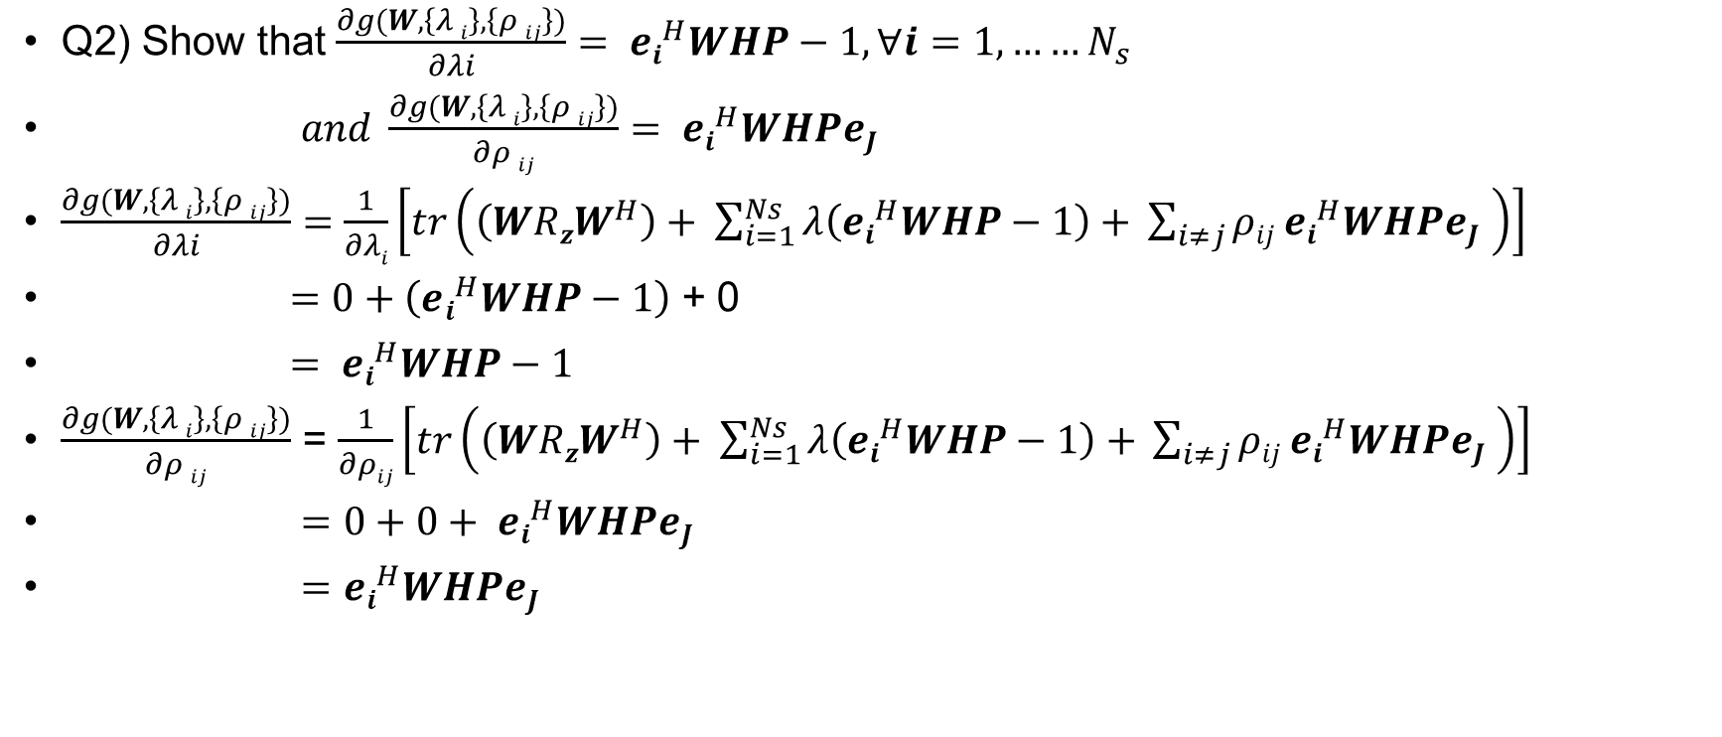
MIMO without CSIT – RxZF
Q2) Show that $\frac{∂g(W,\left\{λ i\right\},\left\{ρ ij\right\})}{∂λi}= ei^{H}WHP−1,∀i=1,……N_{s}$
$and \frac{∂g(W,\left\{λ i\right\},\left\{ρ ij\right\})}{∂ρ ij}= ei^{H}WHPeJ$
$\frac{∂g(W,\left\{λ i\right\},\left\{ρ ij\right\})}{∂λi}=\frac{1}{∂λi}\left[tr\left(\left(WRzW^{H}\right)+ \sum_{i=1}^{Ns}{λ\left(ei^{H}WHP−1\right)+ }\sum_{i≠j}{ρij ei^{H}WHPeJ }\right)\right]$
$=0+\left(ei^{H}WHP−1\right)$ + 0
$= ei^{H}WHP−1$
$\frac{∂g(W,\left\{λ i\right\},\left\{ρ ij\right\})}{∂ρ ij}$ = $\frac{1}{∂ρij}\left[tr\left(\left(WRzW^{H}\right)+ \sum_{i=1}^{Ns}{λ\left(ei^{H}WHP−1\right)+ }\sum_{i≠j}{ρij ei^{H}WHPeJ }\right)\right]$
$=0+0+ ei^{H}WHPeJ$
$=ei^{H}WHPeJ$

Slide 13
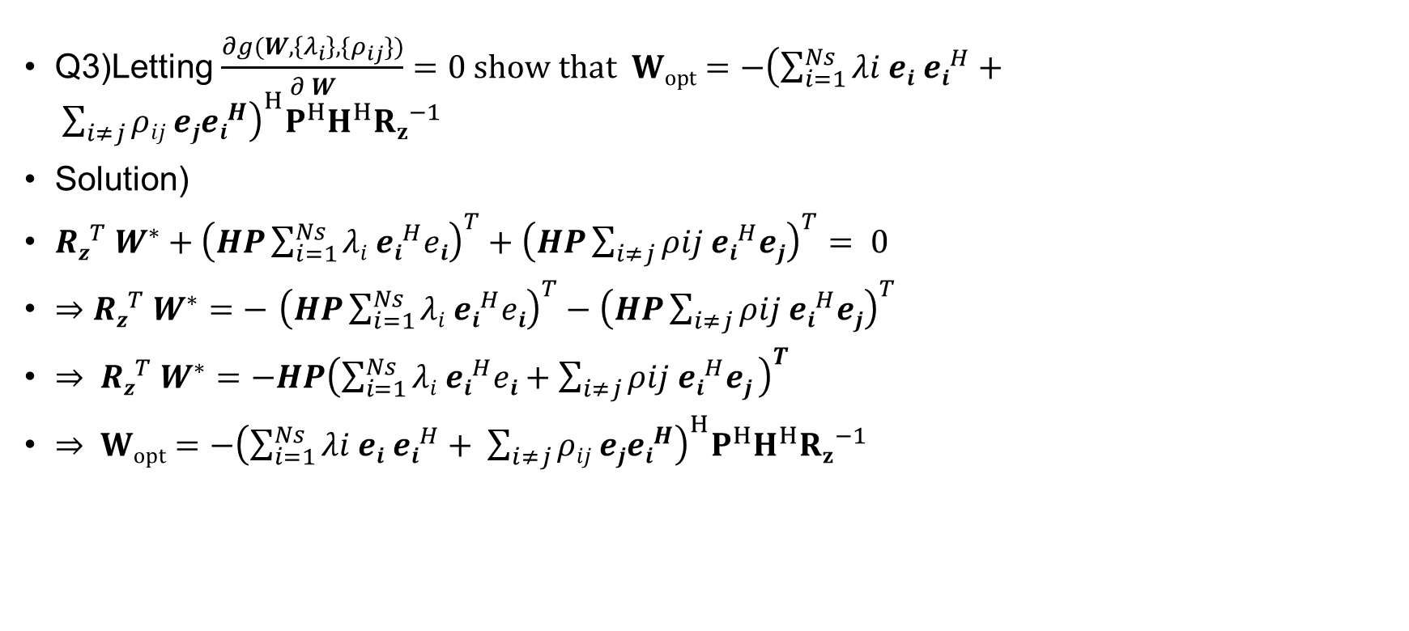
MIMO without CSIT – RxZF
Q3)Letting $\frac{∂g(W,\left\{λ_{i}\right\},\{ρ_{ij}\})}{∂ W}=0 show that Wopt=−{\left(\sum_{i=1}^{Ns}{λi ei ei^{H}}+ \sum_{i≠j}{ρij ejei^{H}}\right)}^{H}P^{H}H^{H}{Rz}^{−1}$
Solution)
$Rz^{T} W^{∗}+{\left(HP\sum_{i=1}^{Ns}{λi ei^{H}ei}\right)}^{T}+{\left(HP\sum_{i≠j}{ρij ei^{H}ej}\right)}^{T}= 0$
$⇒$ $Rz^{T} W^{∗}=−$ ${\left(HP\sum_{i=1}^{Ns}{λi ei^{H}ei}\right)}^{T}−{\left(HP\sum_{i≠j}{ρij ei^{H}ej}\right)}^{T}$
$⇒ Rz^{T} W^{∗}=−HP{\left(\sum_{i=1}^{Ns}{λi ei^{H}ei}+\sum_{i≠j}{ρij ei^{H}ej} \right)}^{T}$
$⇒ Wopt=−{\left(\sum_{i=1}^{Ns}{λi ei ei^{H}}+ \sum_{i≠j}{ρij ejei^{H}}\right)}^{H}P^{H}H^{H}{Rz}^{−1}$

Slide 14
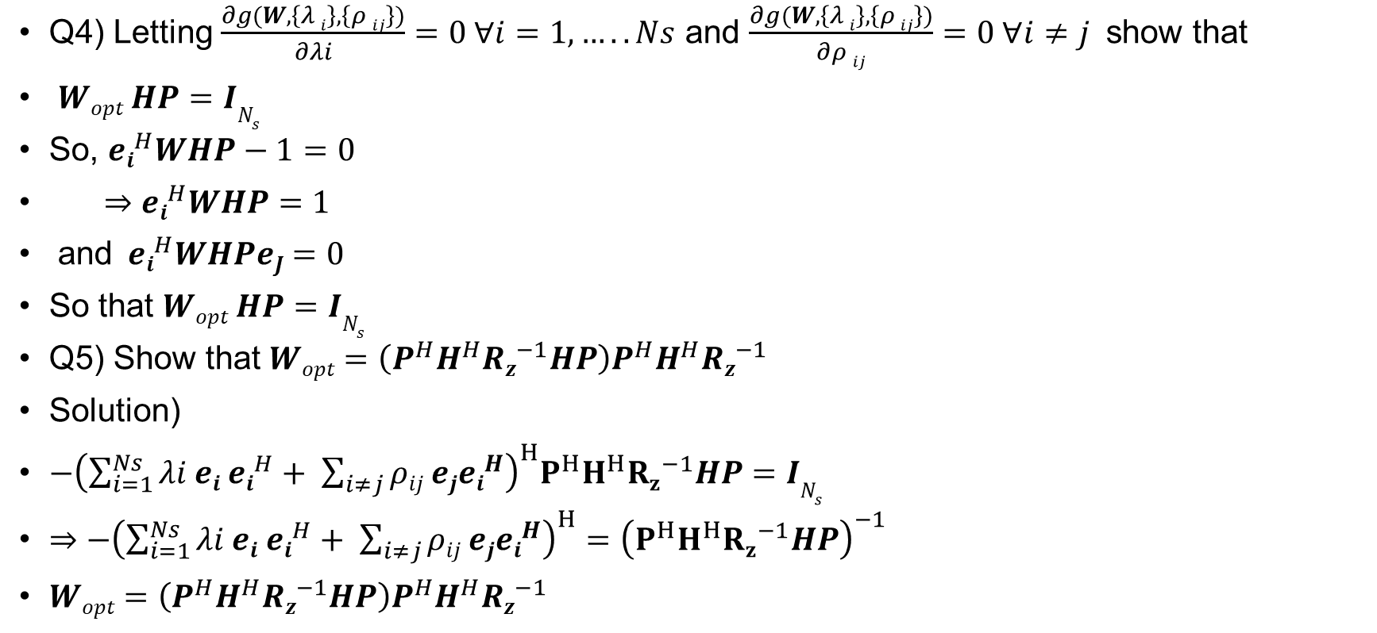
MIMO without CSIT – RxZF
Q4) Letting $\frac{∂g(W,\left\{λ i\right\},\left\{ρ ij\right\})}{∂λi}=0 ∀i=1,…..Ns$ and $\frac{∂g(W,\left\{λ i\right\},\left\{ρ ij\right\})}{∂ρ ij}=0 ∀i≠j$ show that
$Wopt HP=IN_{s}$
So, $ei^{H}WHP−1=0$
$⇒$ $ei^{H}WHP=1$
and$ei^{H}WHPeJ=0$
So that $Wopt HP=IN_{s}$
Q5) Show that $Wopt=\left(P^{H}H^{H}Rz^{−1}HP\right)P^{H}H^{H}Rz^{−1}$
Solution)
$−{\left(\sum_{i=1}^{Ns}{λi ei ei^{H}}+ \sum_{i≠j}{ρij ejei^{H}}\right)}^{H}P^{H}H^{H}{Rz}^{−1}HP=IN_{s}$
$⇒$ $−{\left(\sum_{i=1}^{Ns}{λi ei ei^{H}}+ \sum_{i≠j}{ρij ejei^{H}}\right)}^{H}={\left(P^{H}H^{H}{Rz}^{−1}HP\right)}^{−1}$
$Wopt=\left(P^{H}H^{H}Rz^{−1}HP\right)P^{H}H^{H}Rz^{−1}$

Slide 15
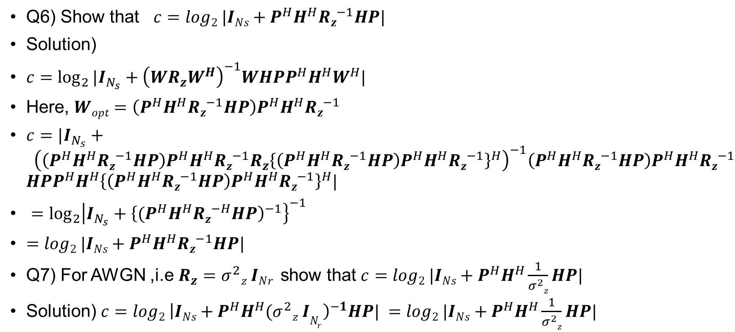
MIMO without CSIT – RxZF
Q6) Show that $c=log2 |INs+P^{H}H^{H}Rz^{−1}HP|$
Solution)
$c=\log_{2}{|I_{N_{s}}+{\left(WR_{z}W^{H}\right)}^{−1}WHPP^{H}H^{H}W^{H}|}$
Here, $Wopt=\left(P^{H}H^{H}Rz^{−1}HP\right)P^{H}H^{H}Rz^{−1}$
$c=|I_{N_{s}}+ {\left(\left(P^{H}H^{H}Rz^{−1}HP\right)P^{H}H^{H}Rz^{−1}R_{z}{\left\{\left(P^{H}H^{H}Rz^{−1}HP\right)P^{H}H^{H}Rz^{−1}\right\}}^{H}\right)}^{−1}\left(P^{H}H^{H}Rz^{−1}HP\right)P^{H}H^{H}Rz^{−1}$ $HPP^{H}H^{H}{\left\{\left(P^{H}H^{H}Rz^{−1}HP\right)P^{H}H^{H}Rz^{−1}\right\}}^{H}|$
$=\log_{2}{{\left|I_{N_{s}}+{\left\{{(P}^{H}H^{H}Rz^{−H}HP\right)}^{−1}\right\}}^{−1}}$
$=log2 |INs+P^{H}H^{H}Rz^{−1}HP|$
Q7) For AWGN ,i.e $R_{z}=σ^{2}z INr$show that $c=log2 |INs+P^{H}H^{H}\frac{1}{σ^{2}z}HP|$
Solution) $c=log2 {\left|INs+P^{H}H^{H}{(σ}^{2}z IN_{r}\right)}^{−1}HP| =log2 |INs+P^{H}H^{H}\frac{1}{σ^{2}z}HP|$

Slide 16
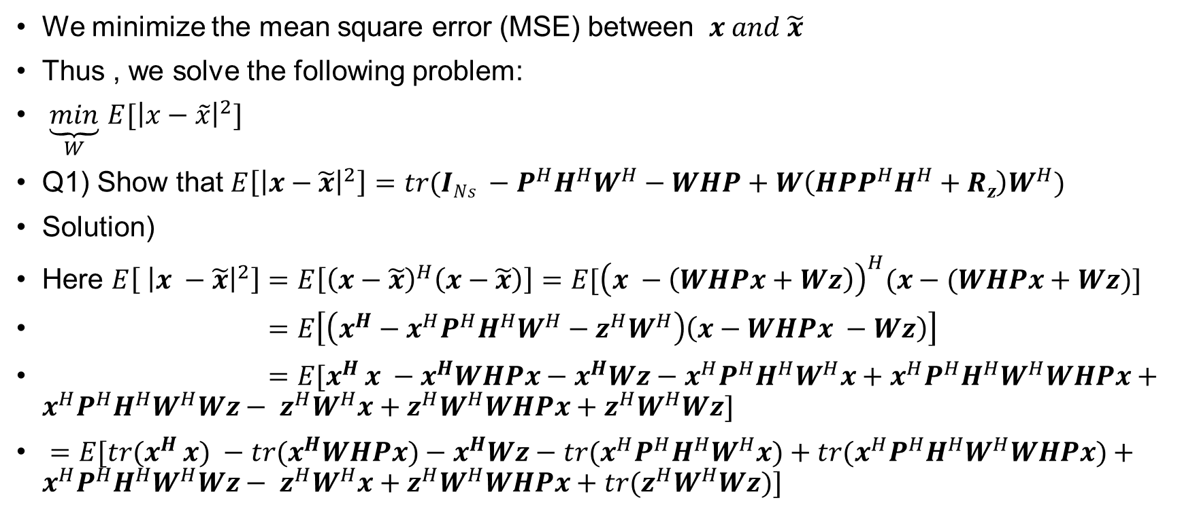
MIMO without CSIT – RxMMSE
We minimize the mean square error (MSE) between $x and \tilde{x}$
Thus , we solve the following problem:
$\underset{W}{\underbrace{min}}$ $E[{\left|x−\tilde{x}\right|}^{2}]$
Q1) Show that $E\left[{\left|x−\tilde{x}\right|}^{2}\right]=tr(INs −P^{H}H^{H}W^{H}−WHP+W\left(HPP^{H}H^{H}+Rz\right)W^{H})$
Solution)
Here $E\left[ {\left|x −\tilde{x}\right|}^{2}\right]=E\left[{\left(x−\tilde{x}\right)}^{H}\left(x−\tilde{x}\right)\right]=E[{\left(x −\left(WHPx+Wz\right)\right)}^{H}(x−(WHPx+Wz)]$
$=E\left[\left(x^{H}−x^{H}P^{H}H^{H}W^{H}−z^{H}W^{H}\right)\left(x−WHPx −Wz\right)\right]$
$=E[x^{H }x −x^{H}WHPx−x^{H}Wz−x^{H}P^{H}H^{H}W^{H}x+x^{H}P^{H}H^{H}W^{H}WHPx+x^{H}P^{H}H^{H}W^{H}Wz− z^{H}W^{H}x+z^{H}W^{H}WHPx+z^{H}W^{H}Wz]$
$=E[{tr(x}^{H }x) −tr(x^{H}WHPx)−x^{H}Wz−{tr(x}^{H}P^{H}H^{H}W^{H}x)+{tr(x}^{H}P^{H}H^{H}W^{H}WHPx)+x^{H}P^{H}H^{H}W^{H}Wz− z^{H}W^{H}x+z^{H}W^{H}WHPx+{tr(z}^{H}W^{H}Wz)]$

Slide 17
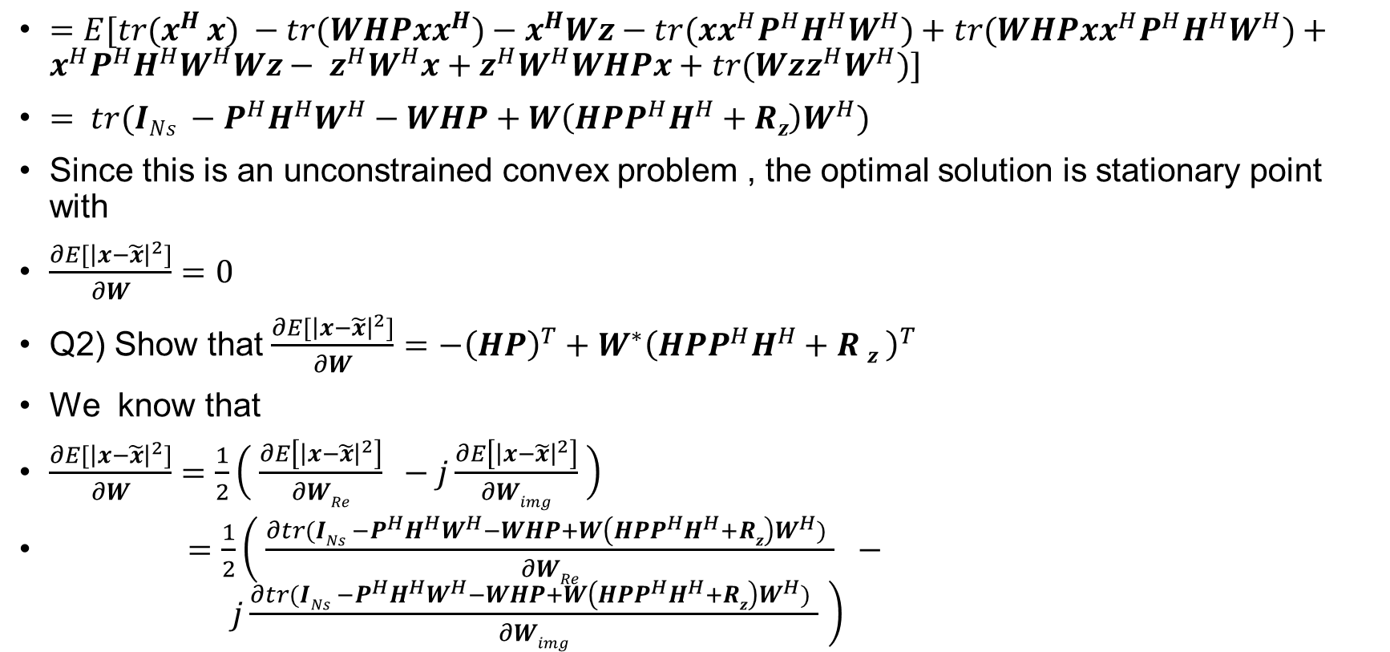
MIMO without CSIT – RxMMSE
$=E[{tr(x}^{H }x) −tr(WHPxx^{H})−x^{H}Wz−{tr(xx}^{H}P^{H}H^{H}W^{H})+{tr(WHPxx}^{H}P^{H}H^{H}W^{H})+x^{H}P^{H}H^{H}W^{H}Wz− z^{H}W^{H}x+z^{H}W^{H}WHPx+{tr(Wzz}^{H}W^{H})]$
$= tr(INs −P^{H}H^{H}W^{H}−WHP+W\left(HPP^{H}H^{H}+Rz\right)W^{H})$
Since this is an unconstrained convex problem , the optimal solution is stationary point with
$\frac{∂E[{\left|x−\tilde{x}\right|}^{2}]}{∂W}=0$
Q2) Show that $\frac{∂E[{\left|x−\tilde{x}\right|}^{2}]}{∂W}=$ $−{\left(HP\right)}^{T}+W^{∗}{\left(HPP^{H}H^{H}+R z \right)}^{T}$
We know that
$\frac{∂E[{\left|x−\tilde{x}\right|}^{2}]}{∂W}=\frac{1}{2}\left( \frac{∂E\left[{\left|x−\tilde{x}\right|}^{2}\right]}{∂WRe} −j\frac{∂E\left[{\left|x−\tilde{x}\right|}^{2}\right]}{∂Wimg} \right)$
$=\frac{1}{2}\left( \frac{∂tr(INs −P^{H}H^{H}W^{H}−WHP+W\left(HPP^{H}H^{H}+Rz\right)W^{H}) }{∂WRe} − j\frac{∂tr(INs −P^{H}H^{H}W^{H}−WHP+W\left(HPP^{H}H^{H}+Rz\right)W^{H}) }{∂Wimg} \right)$

Slide 18
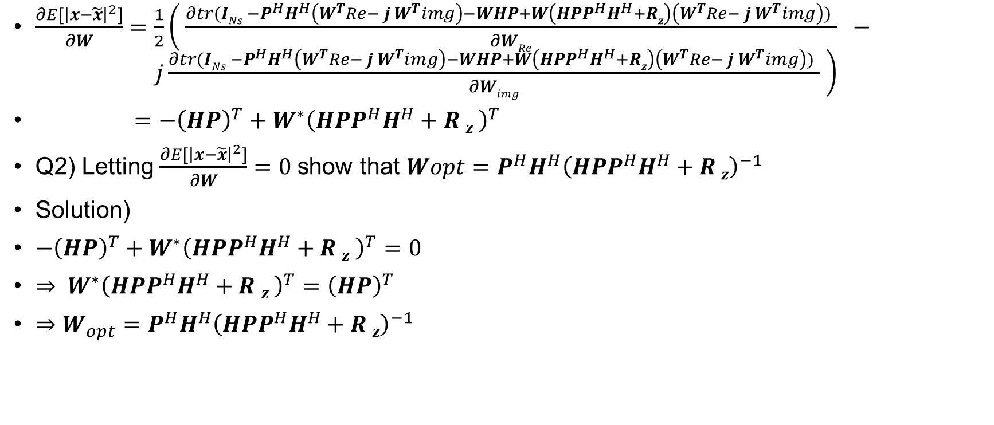
MIMO without CSIT – RxMMSE
$\frac{∂E[{\left|x−\tilde{x}\right|}^{2}]}{∂W}$ $=\frac{1}{2}\left( \frac{∂tr(INs −P^{H}H^{H}\left(W^{T}Re− j W^{T}img\right)−WHP+W\left(HPP^{H}H^{H}+Rz\right)\left(W^{T}Re− j W^{T}img\right)) }{∂WRe} − j\frac{∂tr(INs −P^{H}H^{H}\left(W^{T}Re− j W^{T}img\right)−WHP+W\left(HPP^{H}H^{H}+Rz\right)\left(W^{T}Re− j W^{T}img\right)) }{∂Wimg} \right)$
$=$ $−{\left(HP\right)}^{T}+W^{∗}{\left(HPP^{H}H^{H}+R z \right)}^{T}$
Q2) Letting $\frac{∂E[{\left|x−\tilde{x}\right|}^{2}]}{∂W}=0$show that $Wopt=P^{H}H^{H}{\left(HPP^{H}H^{H}+R z\right)}^{−1}$
Solution)
$−{\left(HP\right)}^{T}+W^{∗}{\left(HPP^{H}H^{H}+R z \right)}^{T}=0$
$⇒ W^{∗}{\left(HPP^{H}H^{H}+R z \right)}^{T}={\left(HP\right)}^{T}$
$⇒W_{opt}=P^{H}H^{H}{\left(HPP^{H}H^{H}+R z\right)}^{−1}$

Slide 19
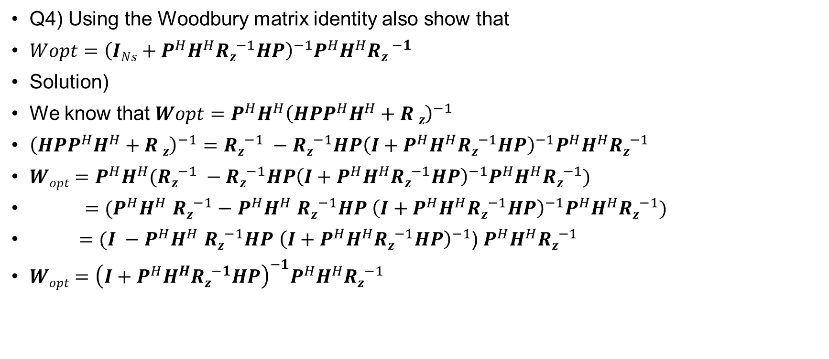
MIMO without CSIT – RxMMSE
Q4) Using the Woodbury matrix identity also show that
$Wopt={\left(INs+P^{H}H^{H}Rz^{−1}HP\right)}^{−1}P^{H}H^{H}R{z }^{−1}$
Solution)
We know that $Wopt=P^{H}H^{H}{\left(HPP^{H}H^{H}+R z\right)}^{−1}$
${\left(HPP^{H}H^{H}+R z\right)}^{−1}=Rz^{−1} −Rz^{−1}HP{\left(I+P^{H}H^{H}Rz^{−1}HP\right)}^{−1}P^{H}H^{H}Rz^{−1}$
$Wopt=P^{H}H^{H}(Rz^{−1} −Rz^{−1}HP{\left(I+P^{H}H^{H}Rz^{−1}HP\right)}^{−1}P^{H}H^{H}Rz^{−1})$
$=$ $(P^{H}H^{H}$ $Rz^{−1}−$ $P^{H}H^{H}$ $Rz^{−1}HP$ ${\left(I+P^{H}H^{H}Rz^{−1}HP\right)}^{−1}P^{H}H^{H}Rz^{−1})$
$=(I −P^{H}H^{H} Rz^{−1}HP {\left(I+P^{H}H^{H}Rz^{−1}HP\right)}^{−1}$) $P^{H}H^{H}Rz^{−1}$
$Wopt={\left(I+P^{H}H^{H}Rz^{−1}HP\right)}^{−1}P^{H}H^{H}Rz^{−1}$

Slide 20
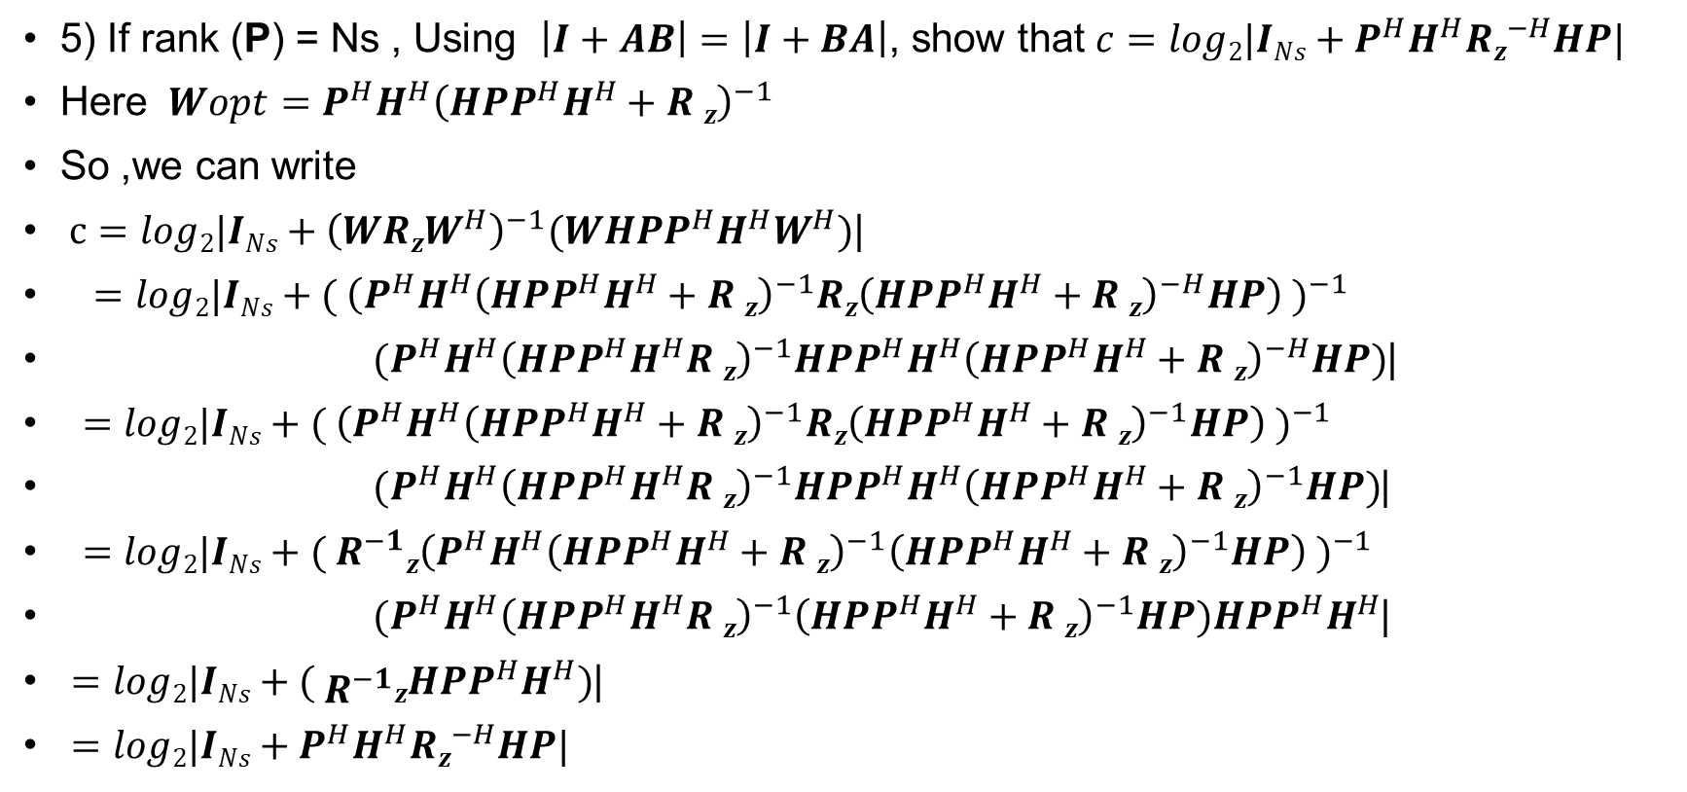
MIMO without CSIT – RxMMSE
5) If rank (P) = Ns , Using $\left|I+AB\right|=\left|I+BA\right|$, show that $c=log2|INs+P^{H}H^{H}Rz^{−H}HP|$
Here $Wopt=P^{H}H^{H}{\left(HPP^{H}H^{H}+R z\right)}^{−1}$
So ,we can write
$c=log2|INs+{\left(WRzW^{H}\right)}^{−1}(WHPP^{H}H^{H}W^{H})$|
$=$ $log2|INs+( {\left(P^{H}H^{H}{\left(HPP^{H}H^{H}+R z\right)}^{−1}Rz{\left(HPP^{H}H^{H}+R z\right)}^{−H}HP\right) )}^{−1}$
$(P^{H}H^{H}{\left(HPP^{H}H^{H}R z\right)}^{−1}HPP^{H}H^{H}{\left(HPP^{H}H^{H}+R z\right)}^{−H}HP)$|
$=$ $log2|INs+( {\left(P^{H}H^{H}{\left(HPP^{H}H^{H}+R z\right)}^{−1}Rz{\left(HPP^{H}H^{H}+R z\right)}^{−1}HP\right) )}^{−1}$
$(P^{H}H^{H}{\left(HPP^{H}H^{H}R z\right)}^{−1}HPP^{H}H^{H}{\left(HPP^{H}H^{H}+R z\right)}^{−1}HP)$|
$=$ $log2|INs+( {R^{−1}z\left(P^{H}H^{H}{\left(HPP^{H}H^{H}+R z\right)}^{−1}{\left(HPP^{H}H^{H}+R z\right)}^{−1}HP\right) )}^{−1}$
$(P^{H}H^{H}{\left(HPP^{H}H^{H}R z\right)}^{−1}{\left(HPP^{H}H^{H}+R z\right)}^{−1}HP)HPP^{H}H^{H}$|
$=$ $log2|INs+( R^{−1}zHPP^{H}H^{H})$|
$=log2|INs+P^{H}H^{H}Rz^{−H}HP|$

Slide 21

MIMO without CSIT – RxMMSE
6) if rank $\left(P\right)=N_{s}$for AWGN i.e $Rz=σ^{2}z IN_{r}$show that $c=log2 |IN_{s}+ \frac{1}{σ^{2}z}P^{H}H^{H}PH|$
We can write $c=log2|IN_{s}+P^{H}H^{H}Rz^{−H}HP|$
Just plugging the $Rz=σ^{2}z IN_{r}$ we can write $c=log2 |IN_{s}+ \frac{1}{σ^{2}z}P^{H}H^{H}PH|$

Slide 22
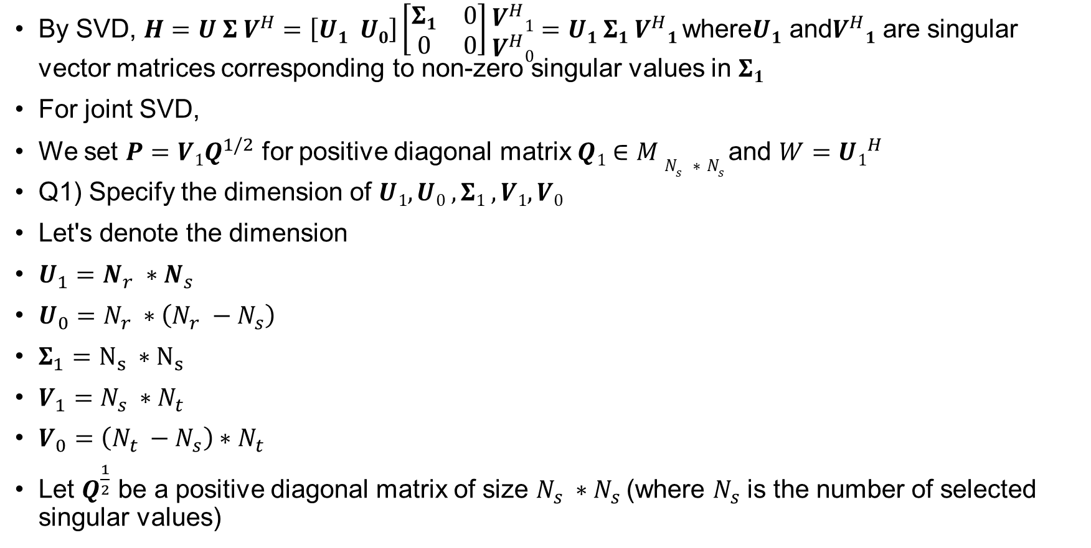
MIMO with CSIT – joint SVD
By SVD, $H=U Σ V^{H}=\left[U1 U0\right]\left[\begin{matrix}Σ1 & 0 \\ 0 & 0\end{matrix}\right]\begin{matrix}V^{H}1 \\ V^{H}0\end{matrix}=U1 Σ1 V^{H}1$ where$U1$ and$V^{H}1$ are singular vector matrices corresponding to non-zero singular values in $Σ1$
For joint SVD,
We set $P=V1Q^{1/2}$ for positive diagonal matrix $Q1∈M N_{s} ∗N_{s}$and $W=U1^{H}$
Q1) Specify the dimension of $U1, U0 , Σ1 , V1, V0$
Let's denote the dimension
$U_{1}=N_{r} ∗N_{s}$
$U_{0}=N_{r} ∗\left(N_{r} −N_{s}\right)$
$Σ_{1}=N_{s} ∗N_{s}$
$V_{1}=N_{s} ∗N_{t}$
$V_{0}=\left(N_{t} −N_{s}\right)∗N_{t}$
Let $Q^{\frac{1}{2}}$ be a positive diagonal matrix of size $N_{s} ∗N_{s}$(where $N_{s}$ is the number of selected singular values)

Slide 23
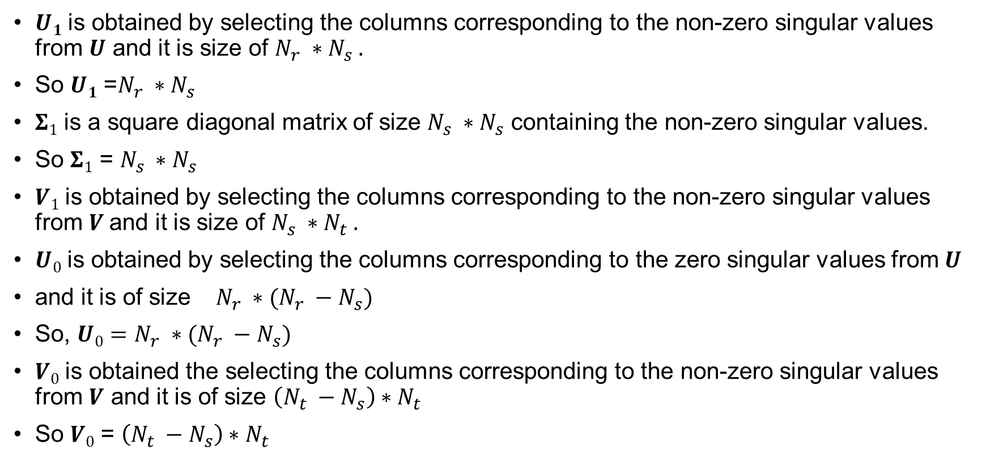
MIMO with CSIT – joint SVD
$U1$ is obtained by selecting the columns corresponding to the non-zero singular values from $U$ and it is size of $N_{r} ∗N_{s} .$
So $U1$ =$N_{r} ∗N_{s}$
$Σ1$ is a square diagonal matrix of size $N_{s} ∗N_{s}$ containing the non-zero singular values.
So $Σ1$ = $N_{s} ∗N_{s}$
$V1$ is obtained by selecting the columns corresponding to the non-zero singular values from$V$ and it is size of $N_{s} ∗N_{t} .$
$U0$ is obtained by selecting the columns corresponding to the zero singular values from $U$
and it is of size $N_{r} ∗(N_{r} −N_{s})$
So, $U0$ $=N_{r} ∗(N_{r} −N_{s})$
$V0$ is obtained the selecting the columns corresponding to the non-zero singular values from $V$ and it is of size $\left(N_{t} −N_{s}\right)∗N_{t}$
So $V0$ = $\left(N_{t} −N_{s}\right)∗N_{t}$

Slide 24

MIMO with CSIT – joint SVD
2) Show that $\tilde{x}=Σ1 x+{U1}^{H} z$
Solution)
We can write $\tilde{x}=W ∗y$
$=W ∗\left(HPx+z\right)$
$=WHPx+Wz$
$={U1}^{H} {U1}^{H}Σ1 {V1}^{H}V1Q^{1/2}x+{U1}^{H}z$
$=$ $Σ1$ $Q^{1/2}x+{U1}^{H}z$

Slide 25
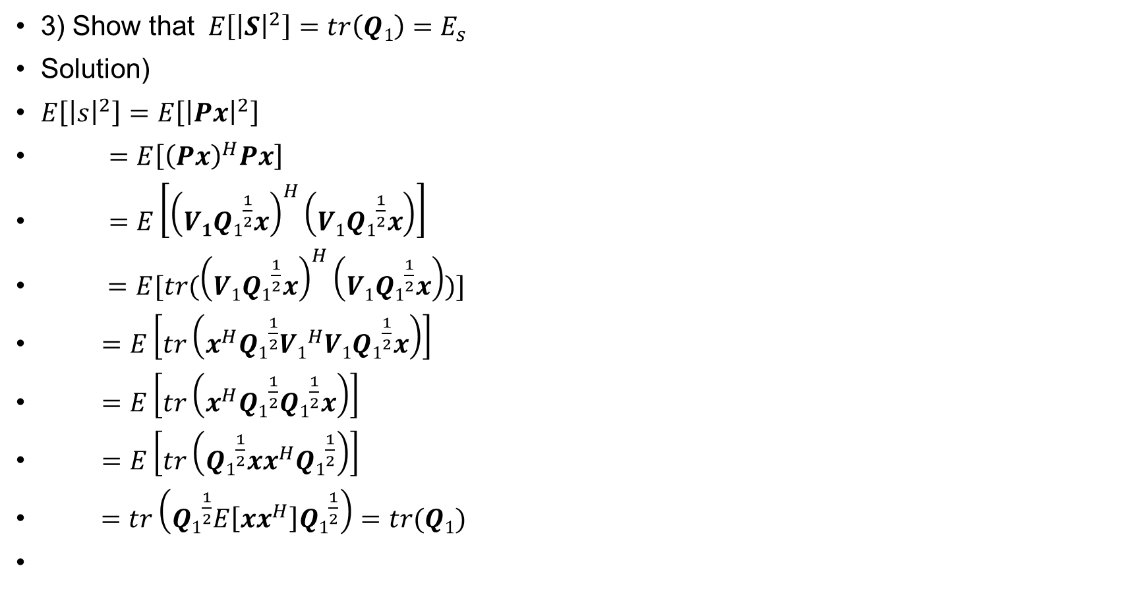
MIMO with CSIT – joint SVD
3) Show that $E\left[{\left|S\right|}^{2}\right]=tr\left(Q1\right)=E_{s}$
Solution)
$E\left[{\left|s\right|}^{2}\right]=E\left[{\left|Px\right|}^{2}\right]$
$=E\left[{\left(Px\right)}^{H}Px\right]$
$=E\left[{\left(V1{Q1}^{\frac{1}{2}}x\right)}^{H}\left({V1Q1}^{\frac{1}{2}}x\right)\right]$
$=E[tr({\left(V1{Q1}^{\frac{1}{2}}x\right)}^{H}\left(V1{Q1}^{\frac{1}{2}}x\right))]$
$=E\left[tr\left(x^{H}{Q1}^{\frac{1}{2}}{V1}^{H}V1{Q1}^{\frac{1}{2}}x\right)\right]$
$=E\left[tr\left(x^{H}{Q1}^{\frac{1}{2}}{Q1}^{\frac{1}{2}}x\right)\right]$
$=E\left[tr\left({Q1}^{\frac{1}{2}}xx^{H}{Q1}^{\frac{1}{2}}\right)\right]$
$=tr\left({Q1}^{\frac{1}{2}}E\left[{xx}^{H}\right]{Q1}^{\frac{1}{2}}\right)=tr(Q1)$

Slide 26
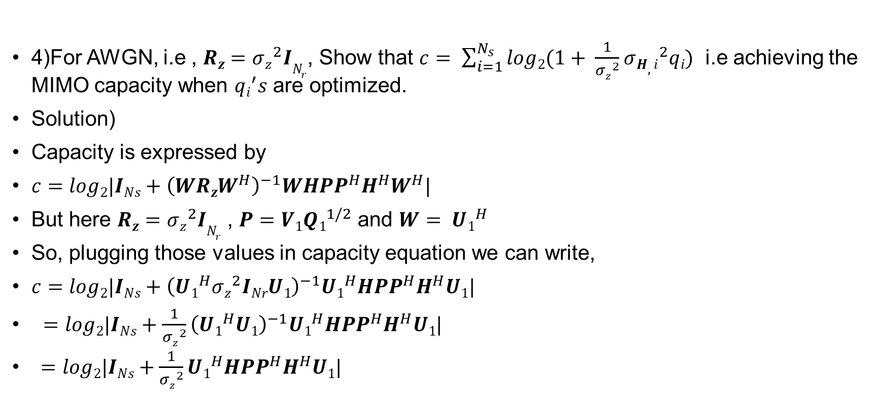
MIMO with CSIT – joint SVD
4)For AWGN, i.e , $Rz={σz}^{2}IN_{r}$, Show that $c= \sum_{i=1}^{N_{s}}{log2(1+ \frac{1}{{σz}^{2}}{σH,i}^{2}qi)}$ i.e achieving the MIMO capacity when $qi^{′}s$are optimized.
Solution)
Capacity is expressed by
$c=log2|INs+{\left(WRzW^{H}\right)}^{−1}WHPP^{H}H^{H}W^{H}|$
But here $Rz={σz}^{2}IN_{r}$ , $P=V1{Q1}^{1/2}$ and $W= {U1}^{H}$
So, plugging those values in capacity equation we can write,
$c=log2|INs+{\left({U1}^{H}{σz}^{2}INrU1\right)}^{−1}{U1}^{H}HPP^{H}H^{H}U1|$
$=log2|INs+{\frac{1}{{σz}^{2}}\left({U1}^{H}U1\right)}^{−1}{U1}^{H}HPP^{H}H^{H}U1|$
$=log2|INs+\frac{1}{{σz}^{2}}{U1}^{H}HPP^{H}H^{H}U1|$

Slide 27
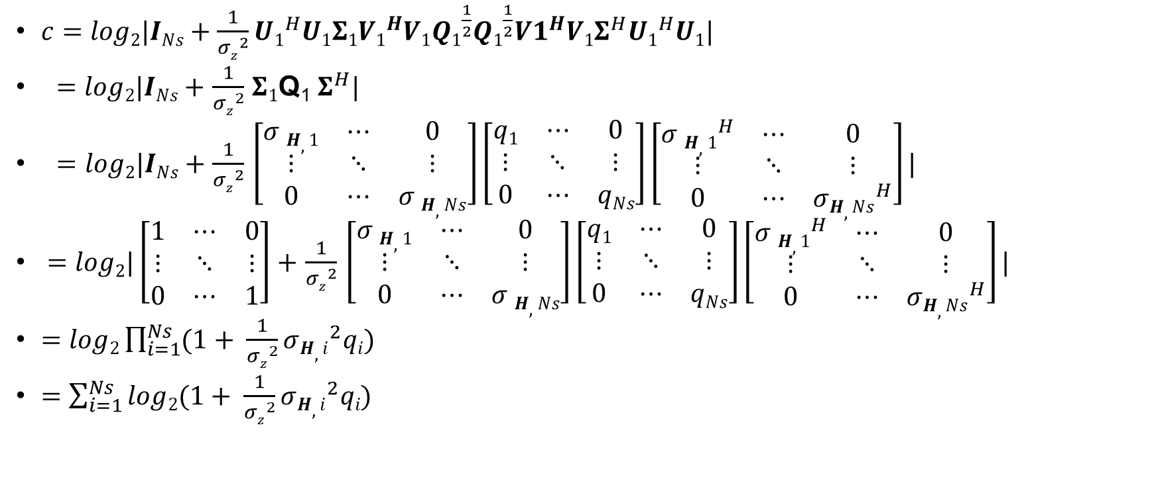
MIMO with CSIT – joint SVD
$c=log2|INs+\frac{1}{{σz}^{2}}{U1}^{H}U1Σ1{V1}^{H}V1{Q1}^{\frac{1}{2}}{Q1}^{\frac{1}{2}}{V1}^{H}V1Σ^{H}{U1}^{H}U1|$
$=$ $log2|INs+$ $\frac{1}{{σz}^{2}}$ $Σ1$Q₁ $Σ^{H}|$
$=log2|INs+$ $\frac{1}{{σz}^{2}}$ $\left[\begin{matrix}σ H,1 & ⋯ & 0 \\ ⋮ & ⋱ & ⋮ \\ 0 & ⋯ & σ H,Ns\end{matrix}\right]\left[\begin{matrix}q1 & ⋯ & 0 \\ ⋮ & ⋱ & ⋮ \\ 0 & ⋯ & qNs\end{matrix}\right]\left[\begin{matrix}{σ H,1}^{H} & ⋯ & 0 \\ ⋮ & ⋱ & ⋮ \\ 0 & ⋯ & {σH,Ns}^{H}\end{matrix}\right]|$
$=log2|\left[\begin{matrix}1 & ⋯ & 0 \\ ⋮ & ⋱ & ⋮ \\ 0 & ⋯ & 1\end{matrix}\right]+$ $\frac{1}{{σz}^{2}}$ $\left[\begin{matrix}σ H,1 & ⋯ & 0 \\ ⋮ & ⋱ & ⋮ \\ 0 & ⋯ & σ H,Ns\end{matrix}\right]\left[\begin{matrix}q1 & ⋯ & 0 \\ ⋮ & ⋱ & ⋮ \\ 0 & ⋯ & qNs\end{matrix}\right]\left[\begin{matrix}{σ H,1}^{H} & ⋯ & 0 \\ ⋮ & ⋱ & ⋮ \\ 0 & ⋯ & {σH,Ns}^{H}\end{matrix}\right]|$
$=log2\prod_{i=1}^{Ns}{(1+ \frac{1}{{σz}^{2}}{σH,i}^{2}qi)}$
$=$ $\sum_{i=1}^{Ns}{log2(1+ \frac{1}{{σz}^{2}}{σH,i}^{2}qi)}$

Slide 28
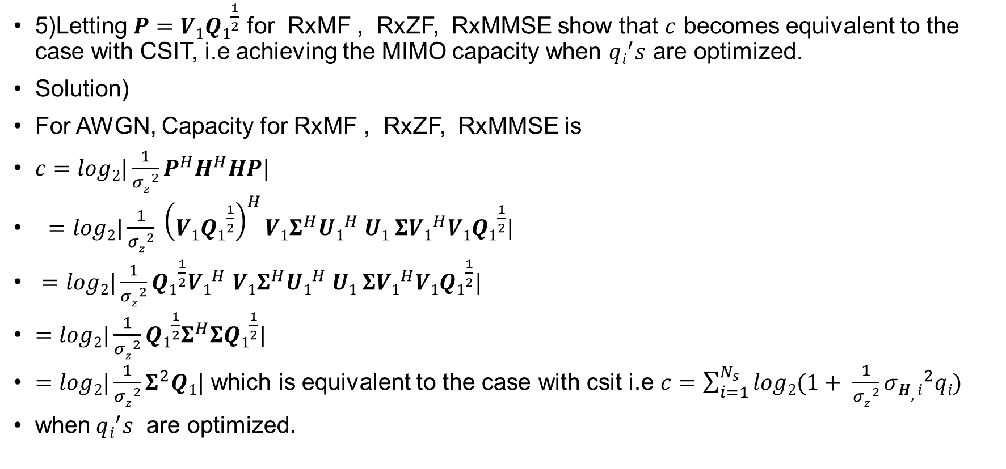
MIMO with CSIT – joint SVD
5)Letting $P=V1{Q1}^{\frac{1}{2}}$ for RxMF , RxZF, RxMMSE show that $c$ becomes equivalent to the case with CSIT, i.e achieving the MIMO capacity when $qi^{′}s$ are optimized.
Solution)
For AWGN, Capacity for RxMF , RxZF, RxMMSE is
$c=log2|\frac{1}{{σz}^{2}}P^{H}H^{H}HP|$
$=log2|\frac{1}{{σz}^{2}} {\left(V1{Q1}^{\frac{1}{2}}\right)}^{H}V1Σ^{H}{U1}^{H} U1 ΣV1^{H}V1{Q1}^{\frac{1}{2}}|$
$=log2|\frac{1}{{σz}^{2}}{Q1}^{\frac{1}{2}}V1^{H}$ $V1Σ^{H}{U1}^{H} U1 ΣV1^{H}V1{Q1}^{\frac{1}{2}}|$
$=log2|\frac{1}{{σz}^{2}}{Q1}^{\frac{1}{2}}Σ^{H}Σ{Q1}^{\frac{1}{2}}|$
$=log2|\frac{1}{{σz}^{2}}Σ^{2}Q1|$ which is equivalent to the case with csit i.e $c=\sum_{i=1}^{N_{s}}{log2(1+ \frac{1}{{σz}^{2}}{σH,i}^{2}qi)}$
when$qi^{′}s$ are optimized.

Slide 29
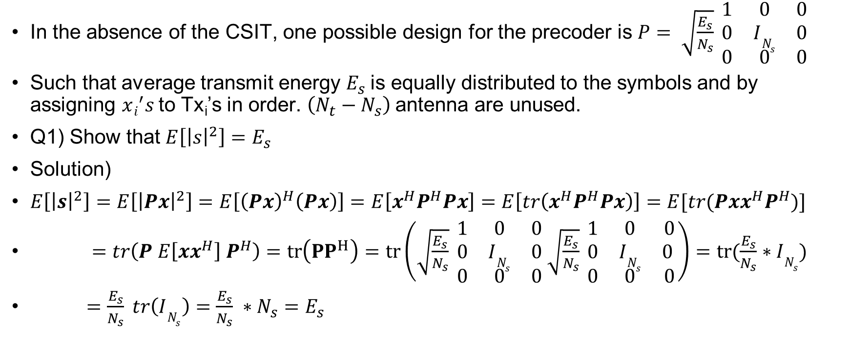
MIMO with CSIT – joint SVD
In the absence of the CSIT, one possible design for the precoder is $P= \sqrt{\frac{E_{s}}{N_{s}}} \begin{matrix}1 & 0 & 0 \\ 0 & IN_{s} & 0 \\ 0 & 0 & 0\end{matrix}$
Such that average transmit energy $E_{s}$is equally distributed to the symbols and by assigning $xi^{′}s$to Tx_{i}’s in order. $\left(N_{t}−N_{s}\right)$antenna are unused.
Q1) Show that $E\left[{\left|s\right|}^{2}\right]=E_{s}$
Solution)
$E\left[{\left|s\right|}^{2}\right]=E\left[{\left|Px\right|}^{2}\right]=E\left[{\left(Px\right)}^{H}\left(Px\right)\right]=E\left[x^{H}P^{H}Px\right]=E\left[tr\left(x^{H}P^{H}Px\right)\right]=E[tr(Pxx^{H}P^{H})]$
$=tr\left(P E\left[{xx}^{H}\right]{ P}^{H}\right)=tr\left({PP}^{H}\right)=tr\left(\sqrt{\frac{E_{s}}{N_{s}}} \begin{matrix}1 & 0 & 0 \\ 0 & IN_{s} & 0 \\ 0 & 0 & 0\end{matrix} \sqrt{\frac{E_{s}}{N_{s}}} \begin{matrix}1 & 0 & 0 \\ 0 & IN_{s} & 0 \\ 0 & 0 & 0\end{matrix}\right)=tr(\frac{E_{s}}{N_{s}}∗IN_{s})$
$=\frac{E_{s}}{N_{s}} tr\left(IN_{s}\right)=\frac{E_{s}}{N_{s}} ∗N_{s}=E_{s}$

Slide 30
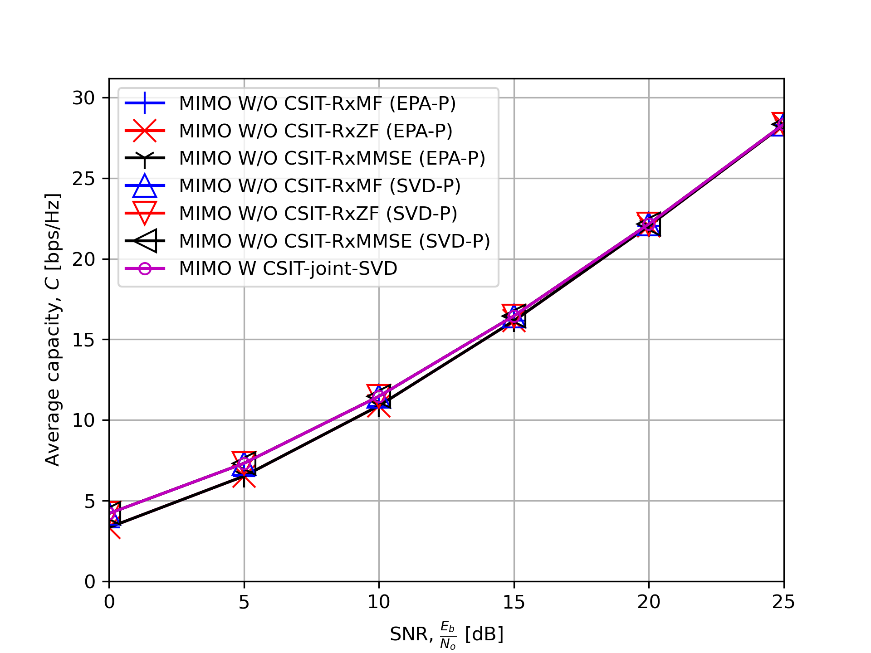

Numerical Results
For $\left(N_{t}, N_{r}\right)=\left(4,4\right)$

Slide 31
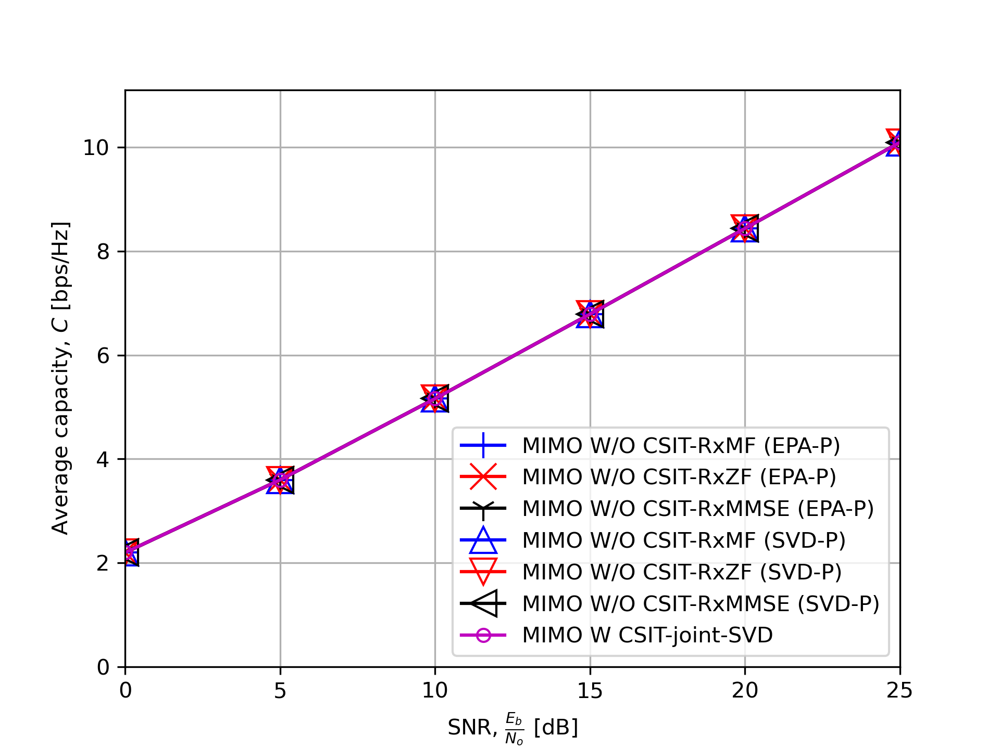

Numerical Results
For $\left(N_{t}, N_{r}\right)=\left(1,4\right)$

Slide 32
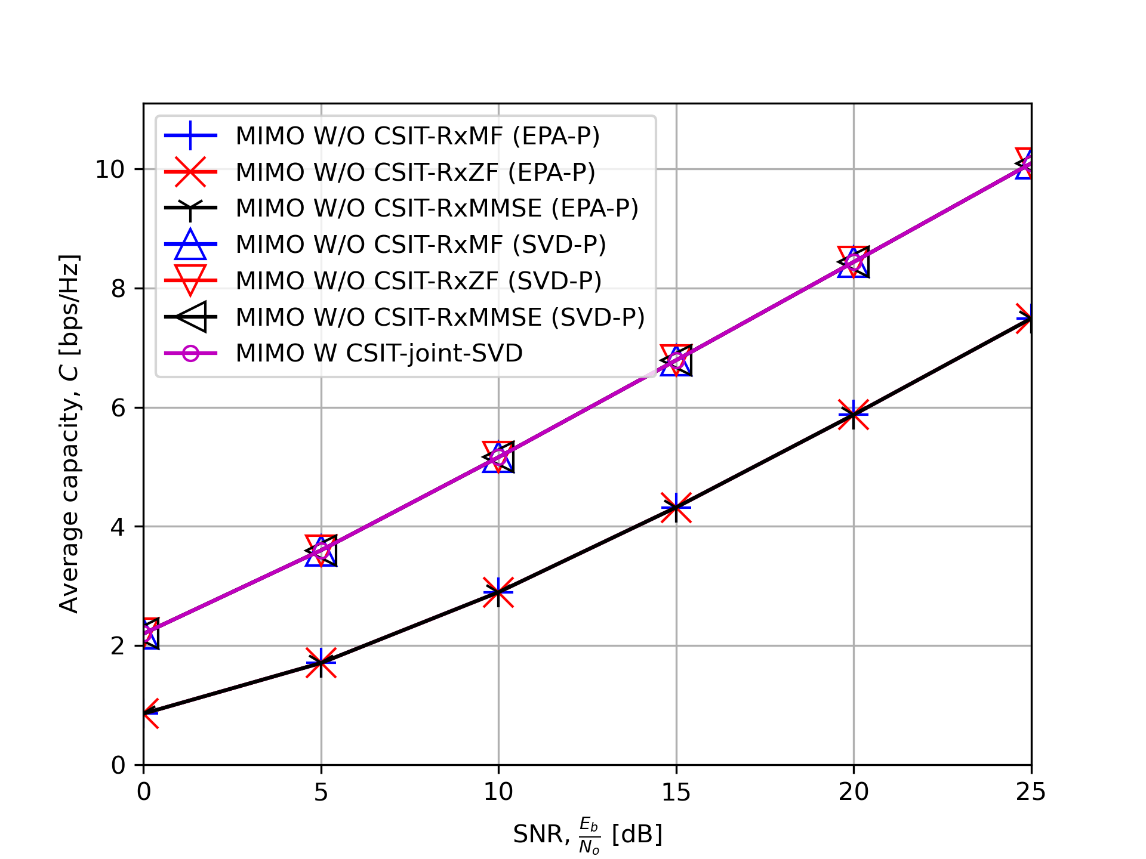

Numerical Results
For $\left(N_{t}, N_{r}\right)=\left(4,1\right)$

Slide 33
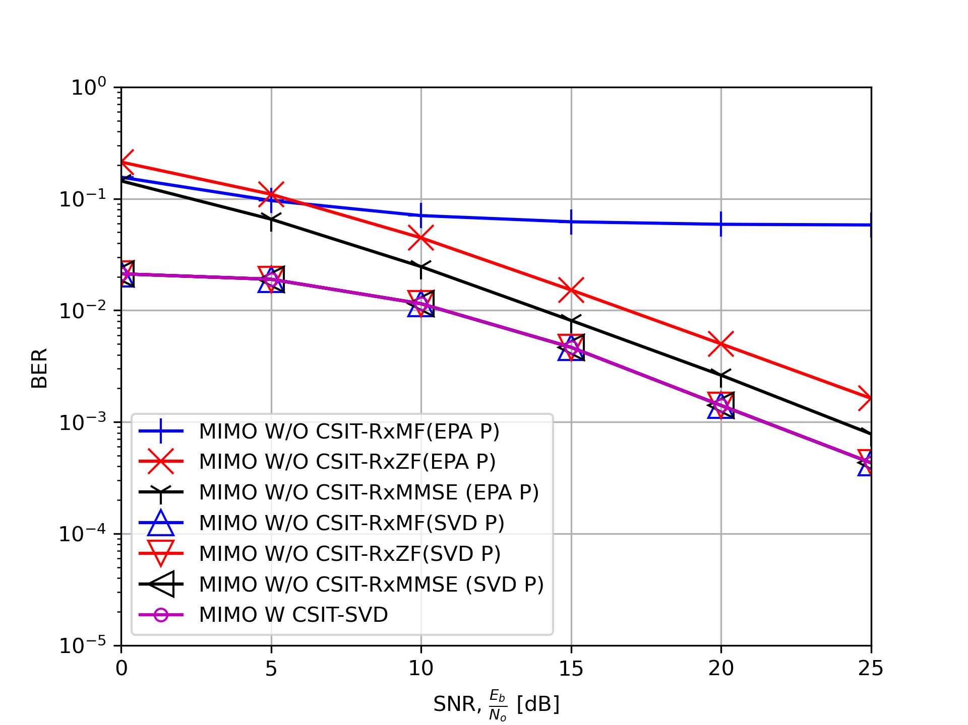

Numerical Results
For BPSK $\left(N_{t}, N_{r}\right)=\left(2,2\right)$

Slide 34
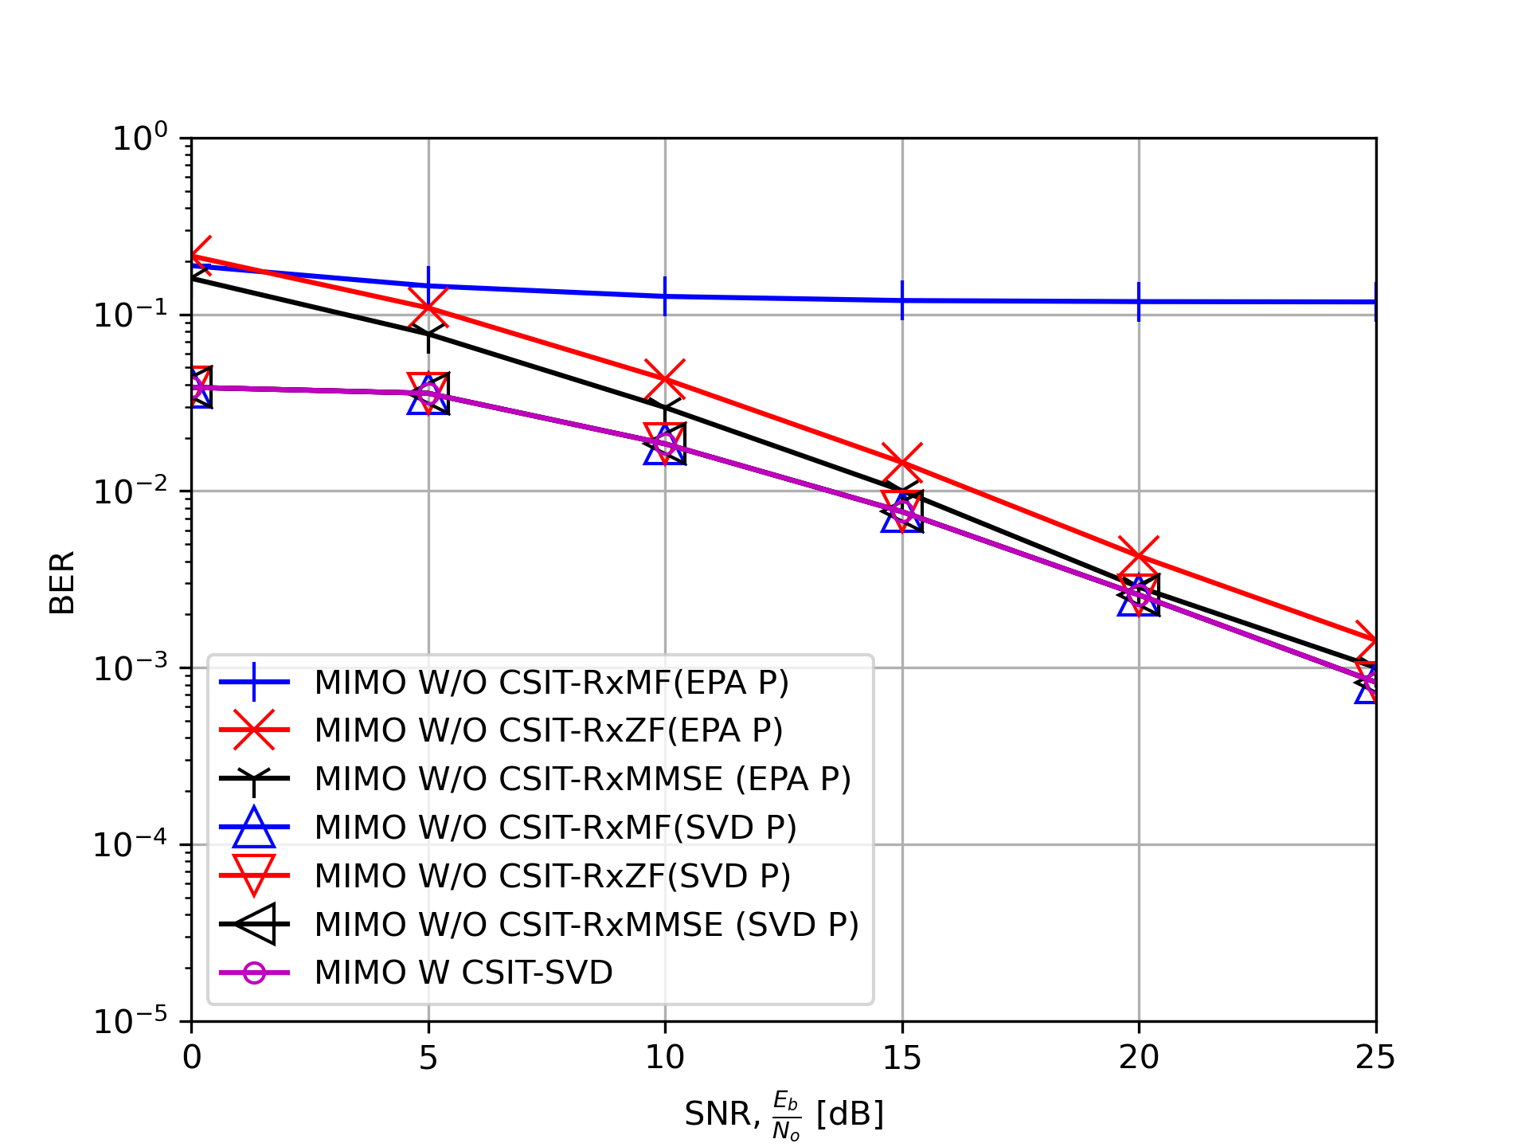

Numerical Results
For QPSK $\left(N_{t}, N_{r}\right)=\left(2,2\right)$

Slide 35
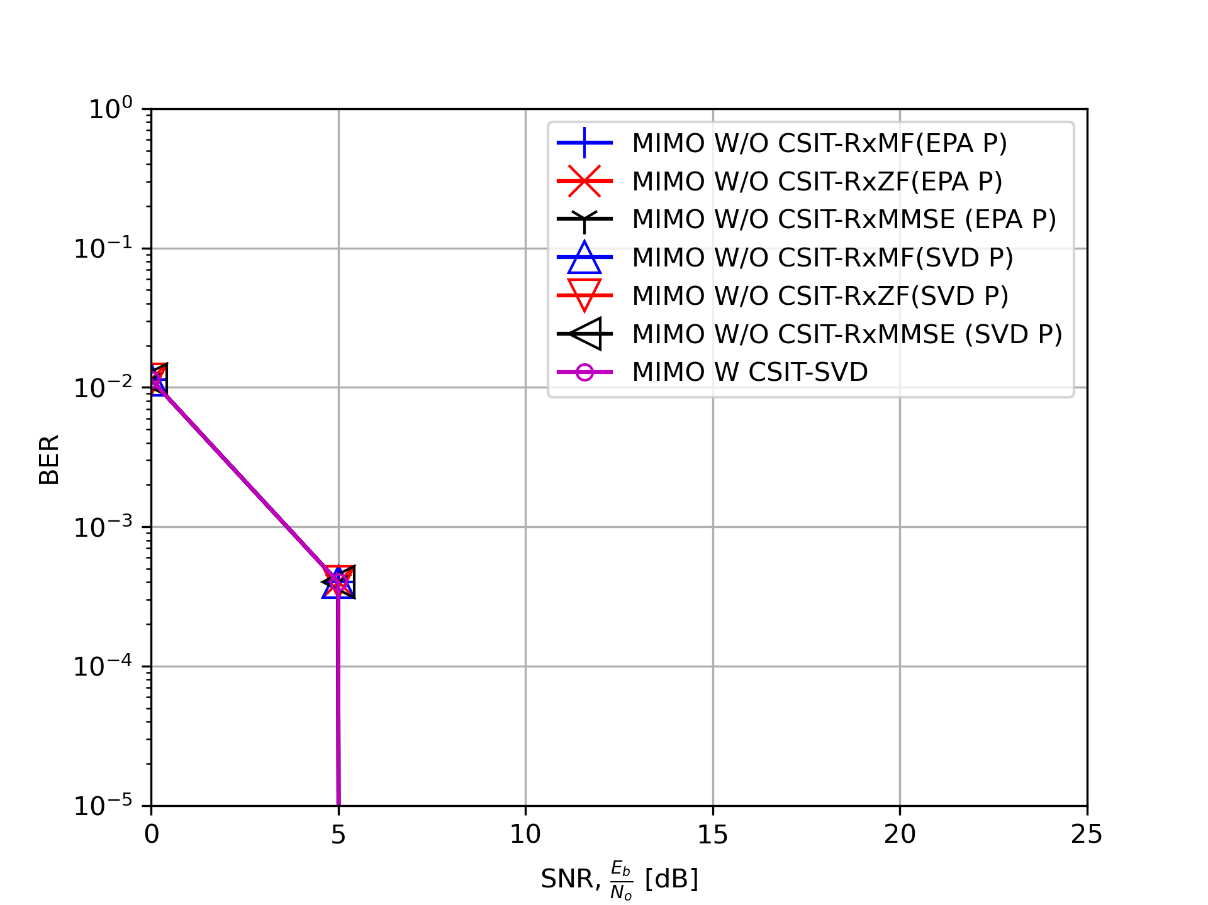

Numerical Results
For QPSK $\left(N_{t}, N_{r}\right)=\left(1,4\right)$

Slide 36
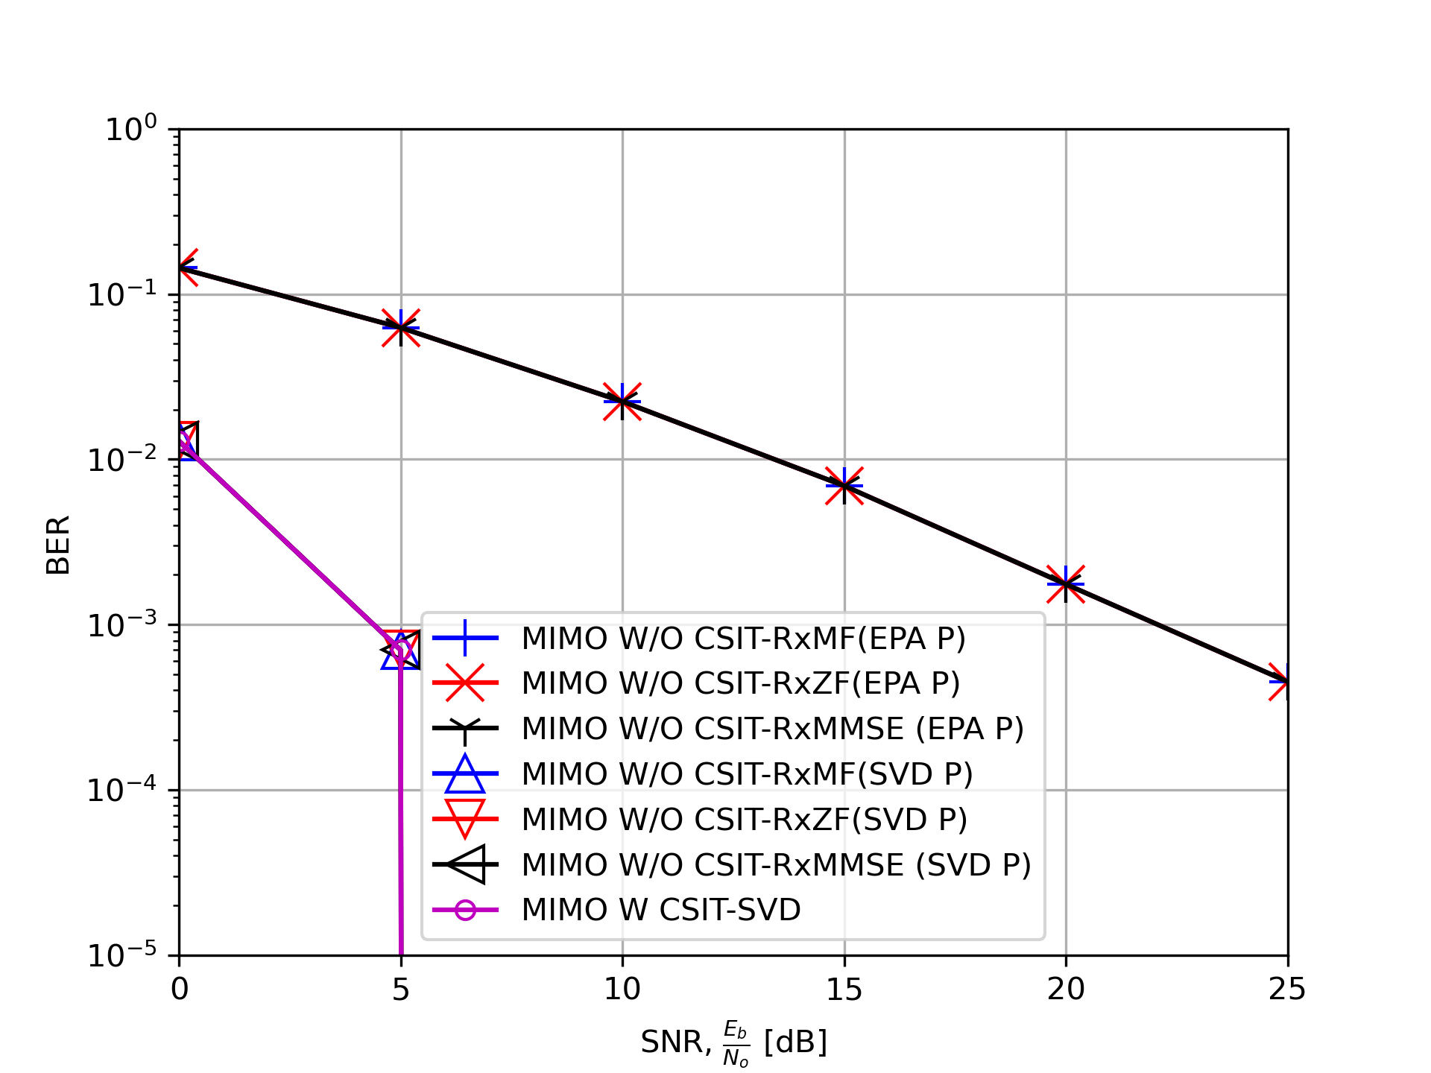

Numerical Results
For QPSK $\left(N_{t}, N_{r}\right)=\left(4,1\right)$

Slide 37
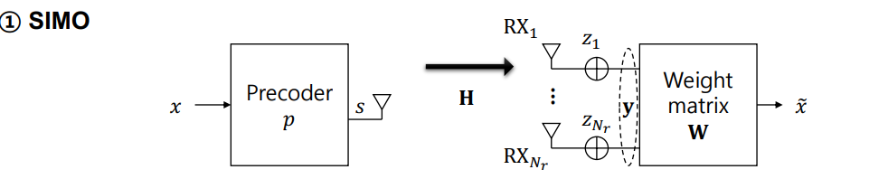
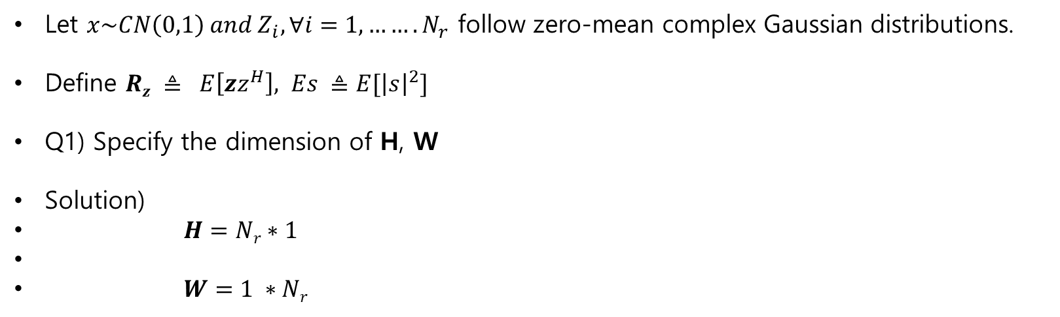
SIMO
Let $x\sim CN\left(0,1\right) and Z_{i}, ∀i=1,…….N_{r}$ follow zero-mean complex Gaussian distributions.
Define $Rz ≜ E\left[{zz}^{H}\right], Es ≜E[{\left|s\right|}^{2}]$
Q1) Specify the dimension of H, W
Solution)
$H=Nr∗1$
$W=1 ∗Nr$

Slide 38
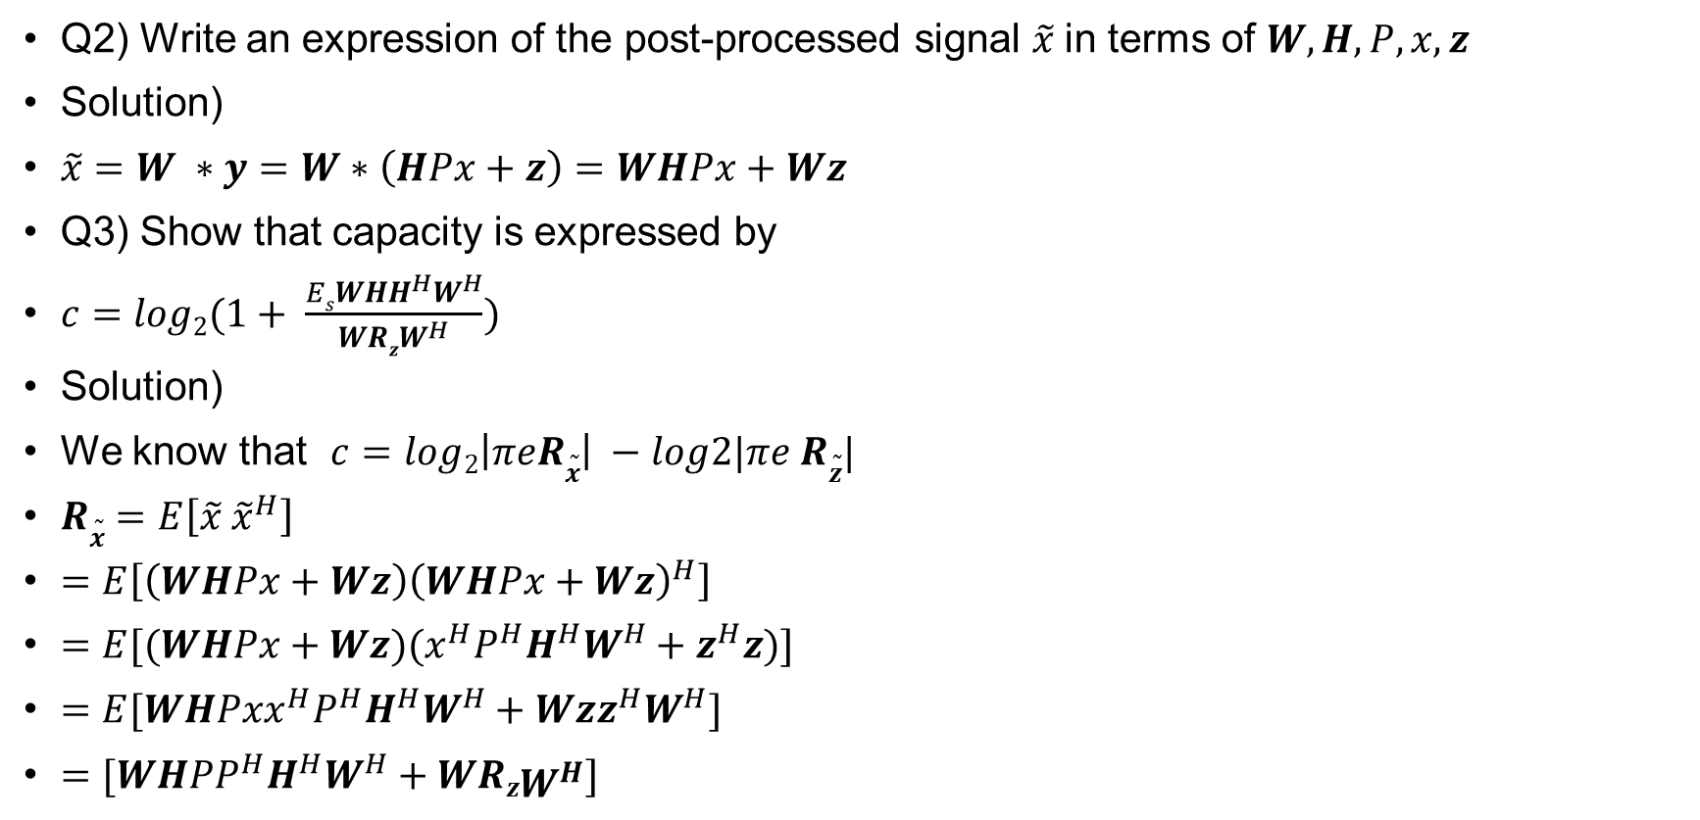
SIMO
Q2) Write an expression of the post-processed signal $\tilde{x}$in terms of $W, H, P, x, z$
Solution)
$\tilde{x}=W ∗y=W∗\left(HPx+z\right)=WHPx+Wz$
Q3) Show that capacity is expressed by
$c=log2(1+ \frac{EsWHH^{H}W^{H}}{WRzW^{H}})$
Solution)
We know that $c=log2\left|πeR\tilde{x}\right| −log2|πe R\tilde{z}|$
$R\tilde{x}=E\left[\tilde{x} {\tilde{x}}^{H}\right]$
$=E\left[\left(WHPx+Wz\right){\left(WHPx+Wz\right)}^{H}\right]$
$=E[(WHPx+Wz)(x^{H}P^{H}H^{H}W^{H}+z^{H}z)]$
$=E[WHPxx^{H}P^{H}H^{H}W^{H}+Wzz^{H}W^{H}]$
$=[WHPP^{H}H^{H}W^{H}+WRzW^{H}]$

Slide 39

SIMO
$R\tilde{z}=E[\tilde{z}{\tilde{z}}^{H}]$
$=E[\left(Wz\right){\left(Wz\right)}^{H}]$
$=E[Wzz^{H}W^{H}]$
$=WRzW^{H}$
So now we can write
$c=log2\left|πeR\tilde{x}\right| −log2|πe R\tilde{z}|$
$=log2\frac{\left|πeR\tilde{x}\right|}{|πe R\tilde{z}| }$
$=log2\frac{\left|πe\right||R\tilde{x}|}{\left|πe\right||R\tilde{z}|}$
$=log2\frac{|R\tilde{x}|}{|R\tilde{z}|}$

Slide 40
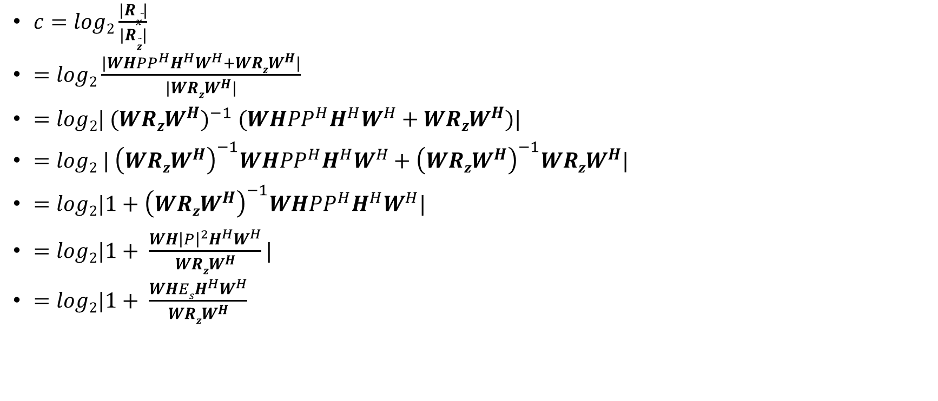
SIMO
$c=log2\frac{|R\tilde{x}|}{|R\tilde{z}|}$
$=log2\frac{|WHPP^{H}H^{H}W^{H}+WRzW^{H}|}{|WRzW^{H}|}$
$=log2| ({WRzW^{H})}^{−1} (WHPP^{H}H^{H}W^{H}+WRzW^{H})|$
$=log2 | {\left(WRzW^{H}\right)}^{−1}WHPP^{H}H^{H}W^{H}+{\left(WRzW^{H}\right)}^{−1}WRzW^{H}|$
$=log2|1+{\left(WRzW^{H}\right)}^{−1}WHPP^{H}H^{H}W^{H}|$
$=log2|1+ \frac{WH{\left|P\right|}^{2}H^{H}W^{H}}{WRzW^{H}}|$
$=log2|1+ \frac{WHEsH^{H}W^{H}}{WRzW^{H}}$

Slide 41

SIMO
Q5) For AWGN, i.e, $Rz={σz}^{2}INr, show that c=log2(1+ \frac{Es}{σ^{2}z} \frac{{\left|H^{H}W^{H}\right|}^{2}}{{\left|W^{H}\right|}^{2}})$
Solution)
$c=log2(1+ \frac{EsWHH^{H}W^{H}}{WRzW^{H}})$
$=log2( 1+ \frac{Es}{{σz}^{2}} \frac{WHH^{H}W^{H}}{WW^{H}} )$
$=log2(1+\frac{Es}{{σz}^{2}} \frac{{\left|H^{H}W^{H}\right|}^{2}}{{\left|W^{H}\right|}^{2}})$

Slide 42
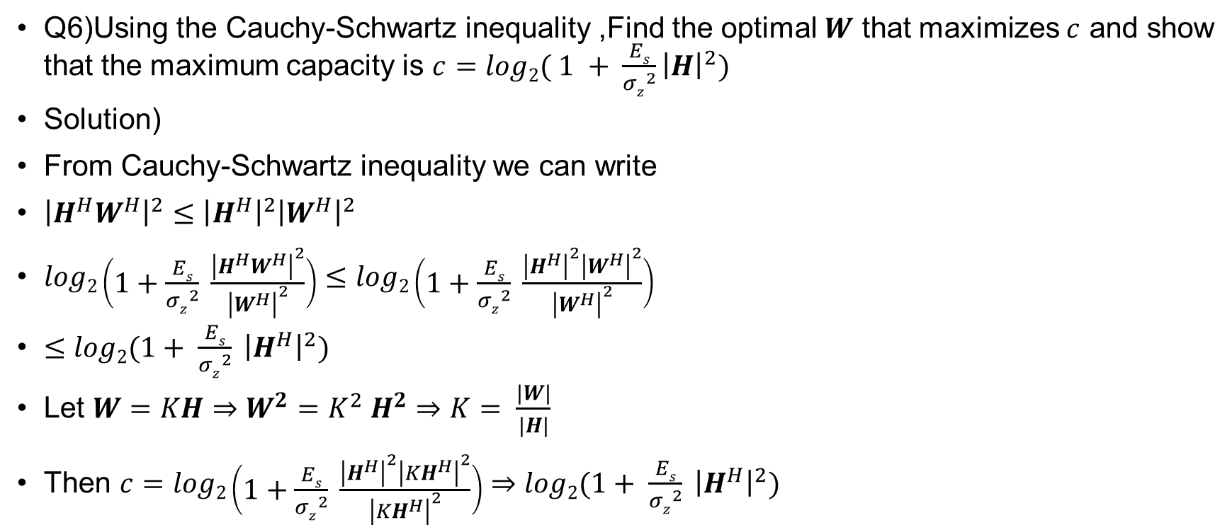
SIMO
Q6)Using the Cauchy-Schwartz inequality ,Find the optimal $W$ that maximizes $c$ and showthat the maximum capacity is $c=log2( 1 + \frac{Es}{{σz}^{2}}{\left|H\right|}^{2})$
Solution)
From Cauchy-Schwartz inequality we can write
${\left|H^{H}W^{H}\right|}^{2}≤{\left|H^{H}\right|}^{2}{\left|W^{H}\right|}^{2}$
$log2\left(1+\frac{Es}{{σz}^{2}} \frac{{\left|H^{H}W^{H}\right|}^{2}}{{\left|W^{H}\right|}^{2}}\right)≤log2\left(1+\frac{Es}{{σz}^{2}} \frac{{\left|H^{H}\right|}^{2}{\left|W^{H}\right|}^{2}}{{\left|W^{H}\right|}^{2}}\right)$
$≤log2(1+ \frac{Es}{{σz}^{2}} {\left|H^{H}\right|}^{2})$
Let $W=KH⇒W^{2}=K^{2} H^{2}⇒K= \frac{|W|}{|H|}$
Then $c=log2\left(1+\frac{Es}{{σz}^{2}} \frac{{\left|H^{H}\right|}^{2}{\left|{KH}^{H}\right|}^{2}}{{\left|{KH}^{H}\right|}^{2}}\right)⇒log2(1+ \frac{Es}{{σz}^{2}} {\left|H^{H}\right|}^{2})$

Slide 43

SIMO
For $W= \frac{1}{{\left|H^{H}\right|}^{2}P}H^{H}$the estimated symbol is $\tilde{x}=x+ \frac{1}{{\left|H^{H}\right|}^{2}\sqrt{E_{s}}} H^{H}z$
$R\tilde{x}=E[\tilde{x}{\tilde{x}}^{H}]$
$=E[\left(x+ \frac{1}{{\left|H^{H}\right|}^{2}\sqrt{E_{s}}} H^{H}z\right){\left(x+ \frac{1}{{\left|H^{H}\right|}^{2}\sqrt{E_{s}}} H^{H}z\right)}^{H}]$
$=E[\left(x+ \frac{1}{{\left|H^{H}\right|}^{2}\sqrt{E_{s}}} H^{H}z\right) \left(x^{H}+ z^{H}H\frac{1}{{\left|H\right|}^{2}\sqrt{E_{s}}} \right)]$
$=E[xx^{H}+\frac{1}{{\left|H^{H}\right|}^{2}\sqrt{E_{s}}}H^{H}zz^{H}H\frac{1}{{\left|H\right|}^{2}\sqrt{E_{s}}}]$
$=(1+ \frac{1}{{\left|H^{H}\right|}^{2}E_{s}}H^{H}{σz}^{2} H\frac{1}{{\left|H\right|}^{2}})$
$=(1+\frac{{σz}^{2}}{{\left|H^{H}\right|}^{2}E_{s}})$

Slide 44

SIMO
$R\tilde{z}=E\left[zz^{H}\right]$
$=E[ \left(\frac{1}{{\left|H^{H}\right|}^{2}\sqrt{E_{s}}} H^{H}z\right){\left(\frac{1}{{\left|H^{H}\right|}^{2}\sqrt{E_{s}}} H^{H}z\right)}^{H}]$
$=\frac{{σz}^{2}}{{\left|H^{H}\right|}^{2}E_{s}}$
$c=log2\left|πeR\tilde{x}\right| −log2|πe R\tilde{z}|$
$=log2\frac{\left|πeR\tilde{x}\right|}{|πe R\tilde{z}| }$
$=log2\frac{\left|πe\right||R\tilde{x}|}{\left|πe\right||R\tilde{z}|}$
$=log2\frac{|R\tilde{x}|}{|R\tilde{z}|}$
$=log2 \frac{|(1+\frac{{σz}^{2}}{{\left|H^{H}\right|}^{2}E_{s}})| }{|\frac{{σz}^{2}}{{\left|H^{H}\right|}^{2}E_{s}}|}$ $=log2| 1+{\left(\frac{{σz}^{2}}{{\left|H^{H}\right|}^{2}E_{s}}\right)}^{−1}|$

Slide 45


MISO
Let $x\sim CN\left(0,1\right) and z\sim \left(0,{σz}^{2}\right)$
Q1) Specify the dimension of P , H
Solution)
$P=Nt ∗1$
$H=1 ∗Nt$

Slide 46

MISO
Q2) Write an expression of the post-processed signal $\tilde{x}$ in terms of $w,H,P,x,z$
$\tilde{x}=w ∗y=w ∗\left(HPx+z\right)=wHPx+wz$
Q3) Show that average transmit energy $Es={\left|P\right|}^{2}$
Solution)
$Es=E\left[{\left|s\right|}^{2}\right]$
$=E\left[{\left|Px\right|}^{2}\right]$
$=E[{\left(Px\right)}^{H}(Px)]$
$=E[x^{H}P^{H}Px]$
$=E[x^{H}{\left|P\right|}^{2}x]$
$= {\left|P\right|}^{2} E[x^{H}x]$
$= {\left|P\right|}^{2}$

Slide 47

MISO
Q4) Show that the capacity is expressed by
$c=log2(1+ \frac{{\left|HP\right|}^{2}}{{σz}^{2}})$
Solution)
$R\tilde{x}=E[\tilde{x}{\tilde{x}}^{H}]$
$=E[\left(wHPx+wz\right){\left(wHPx+wz\right)}^{H}]$
$=E[\left(wHPx+wz\right)(x^{H}P^{H}H^{H}w^{H}+z^{H}w^{H}]$
$=E\left[wHPxx^{H}P^{H}H^{H}w^{H}+wzz^{H}w^{H}\right]$
$=wHPP^{H}H^{H}w^{H}+{σz}^{2} ww^{H}$
$R\tilde{z} =E[\tilde{z}{\tilde{z}}^{H}]$
$=E\left[\left(wz\right){\left(wz\right)}^{H}\right]$
$=E\left[wzz^{H}w\right]= {σz}^{2} ww^{H}$

Slide 48

MISO
$c=log2\left|πeR\tilde{x}\right| −log2|πe R\tilde{z}|$
$=log2\frac{\left|πeR\tilde{x}\right|}{|πe R\tilde{z}| }$
$=log2\frac{\left|πe\right||R\tilde{x}|}{\left|πe\right||R\tilde{z}|}$
$=log2\frac{|R\tilde{x}|}{|R\tilde{z}|}$
$=log2 \frac{|wHPP^{H}H^{H}w^{H}+{σz}^{2} ww^{H}|}{|{σz}^{2} ww^{H}|}$
$=log2| \frac{HPP^{H}H^{H}}{{σz}^{2}}+1|$
$=log2|1+ \frac{{\left|HP\right|}^{2}}{{σz}^{2}}|$

Slide 49

MISO
First Approach : We design $s$ such that the average transmit energy $Es$ is equally distributed to the antennas , i.e
$P= \sqrt{\frac{Es}{Nt}} 1Nt$ (Equal power allocation)
Q5) Show that the capacity is $c=log2(1+ \frac{Es}{Nt {σz}^{2}}{\left|H1Nt\right|}^{2})$
Solution)
$c=log2(1+ \frac{{\left|HP\right|}^{2}}{{σz}^{2}})$
$=log2(1+ \frac{{\left|H\sqrt{\frac{Es}{Nt}} 1Nt\right|}^{2}}{{σz}^{2}})$
$=log2(1+ \frac{Es}{Nt {σz}^{2}}{\left|H1Nt\right|}^{2})$

Slide 50

MISO
Second approach: We design $P= \sqrt{Es} e1$ such that the average transmit energy $Es$is concentrated by assigning $x to TX1 \left(N_{t} −1\right)$ are unused.
Q6) Show that the capacity is $c= log2(1+ \frac{Es}{Nt σ_{z}^{2}}{\left|H\left(1,1\right) \right|}^{2})$
Solution)
$c=log2(1+ \frac{{\left|HP\right|}^{2}}{{σz}^{2}})$
$= log2(1+ \frac{{\left|H\sqrt{Es} e1\right|}^{2}}{{σz}^{2}})$
$= log2(1+ \frac{Es}{Nt {σz}^{2}}{\left|H\left(1,1\right) \right|}^{2})$

Slide 51


MISO
In this case , we can optimize the precoder P to achieve the maximum capacity P
Q1) Using the Cauchy-Schwartz inequality find the optimal P that maximizes $c$with $Es={\left|P\right|}^{2}$
Show that maximum capacity is $c=log2( 1+ \frac{{\left|H^{H}\right|}^{2}}{{σz}^{2}} )$

Slide 52

MISO
Solution)
$c=log2(1+ \frac{{\left|HP\right|}^{2}}{{σz}^{2}})$
Applying the Cauchy-Schwartz inequality
$log2\left(1+ \frac{{\left|HP\right|}^{2}}{{σz}^{2}}\right)≤log2(1+ \frac{{\left|H{\left.​\right|}^{2}|P\right|}^{2}}{{σz}^{2}})$
Let $P=α H^{H}$
$⇒{\left|P\right|}^{2}=α^{2}{\left|H^{H}\right|}^{2}$
$⇒α = \frac{|P|}{|H^{H}|}$
Substituting the $P value$
$c = log2(1+ \frac{{\left|H{\left.​\right|}^{2}|α H^{H}\right|}^{2}}{{σz}^{2}})$

Slide 53

MISO
$c = log2(1+ \frac{{\left|H{\left.​\right|}^{2}{\left|α\right|}^{2}| H^{H}\right|}^{2}}{{σz}^{2}})$
$=log2\left(1+ \frac{{\left|H\right|}^{2} \frac{{\left|P\right|}^{2}}{{\left|H^{H}\right|}^{2}}{\left|H^{H}\right|}^{2}}{{σz}^{2}}\right)$
$=log2(1+ \frac{Es {\left|H\right|}^{2}}{{σz}^{2}})$
Q2)Show that MRT achieves the maximum capacity $c=log2(1+ \frac{{\left|H^{H}\right|}^{2}Es }{{σz}^{2}})$
Solution)
$P= \frac{\sqrt{Es}}{|H^{H}|} H^{H}$

Slide 54

MISO
$\tilde{x}=w ∗y=w ∗\left(HPx+z\right)=wHPx+wz=wH\frac{\sqrt{Es}}{|H^{H}|} H^{H}x+wz$
$R\tilde{x}=E[\tilde{x}{\tilde{x}}^{H}]$
$=E[\left(wH\frac{\sqrt{Es}}{|H^{H}|} H^{H}x+wz\right){\left(wH\frac{\sqrt{Es}}{|H^{H}|} H^{H}x+wz\right)}^{H}]$
$=E[wH\frac{\sqrt{Es}}{\left|H^{H}\right|} H^{H}xx^{H}H\frac{\sqrt{Es}}{\left|H^{H}\right|}H^{H}w^{H} +wzz^{H}w^{H}]$
$= [\frac{Es}{{\left|H^{H}\right|}^{2}}wH H^{H}HH^{H}w^{H} +{σz}^{2}ww^{H}]$
$=$ $\frac{Es}{{\left|H^{H}\right|}^{2}}wH {\left|H\right|}^{2}H^{H}w^{H} +{σz}^{2}ww^{H}$
$= \frac{Es}{{\left|H^{H}\right|}^{2}}w$ ${\left|H\right|}^{2}HH^{H}$ $w^{H}$ $+{σz}^{2}ww^{H}$
$=$ $\frac{Es}{{\left|H^{H}\right|}^{2}}w$ ${\left|H\right|}^{2}{\left|H^{H}\right|}^{2}w^{H}+{σz}^{2}ww^{H}$

Slide 55

MISO
$R\tilde{z}=E[\tilde{z}{\tilde{z}}^{H}]$
$=E[\left(wz\right){\left(wz\right)}^{H}]$
$=E[wzz^{H}w^{H}]$
$= {σz}^{2}ww^{H}$
$c=log2\left|πeR\tilde{x}\right| −log2|πe R\tilde{z}|$
$=log2\frac{\left|πeR\tilde{x}\right|}{|πe R\tilde{z}| }$
$=log2\frac{\left|πe\right||R\tilde{x}|}{\left|πe\right||R\tilde{z}|}$
$=log2\frac{|R\tilde{x}|}{|R\tilde{z}|}$
$= log2\frac{|\frac{Es}{{\left|H^{H}\right|}^{2}}w {\left|H\right|}^{2}{\left|H^{H}\right|}^{2}w^{H}+{σz}^{2}ww^{H}|}{|{σz}^{2}ww^{H}|}=$ $log2\left|1+ \frac{\frac{Es}{{\left|H^{H}\right|}^{2}}{\left|H\right|}^{2}{\left|H^{H}\right|}^{2}}{{σz}^{2}}\right|=log2|1+ \frac{Es{\left|H\right|}^{2}}{{σz}^{2}}|$

Slide 56


SISO
Assume $x\sim CN\left(0,1\right) and z\sim CN\left(0,{σz}^{2}\right)$
Q1) Write an expression of the received signal $\tilde{x }$in terms of $w,h,p,x,z$
Solution)
$\tilde{x} =w ∗y=w ∗\left(hpx+z\right)=whpxz+wz$

Slide 57

SISO
Q2) Show that the average transmit energy is $Es={\left|p\right|}^{2}$
Solution)
$Es=E\left[{\left|px\right|}^{2}\right]$
$=E\left[{\left(px\right)}^{H}\left(px\right)\right]$
$=E\left[x^{H}p^{H}px\right]$
$={\left|p\right|}^{2}E\left[xx^{H}\right]$
$={\left|p\right|}^{2}$
Q3) Show that the capacity is expressed by $c=log2(1+ \frac{{\left|h\right|}^{2}Es}{{σz}^{2}})$
Solution)
$R\tilde{x} =E[\tilde{x}{\tilde{x}}^{H}]$
$=E[\left(whpxz+wz\right){\left(whpxz+wz\right)}^{H}]$

Slide 58

SISO
$R\tilde{x}$ $=E[\left(whpx+wz\right)(x^{H}p^{H}h^{H}w^{H}+z^{H}w^{H})]$
$=E[whpxx^{H}p^{H}h^{H}w^{H}+wzz^{H}w^{H}]$
$=$ $whpp^{H}h^{H}w^{H}+{σz}^{2}ww^{H}$
$R\tilde{z}=E[\tilde{z}{\tilde{z}}^{H}]$
$=E[\left(wz\right){\left(wz\right)}^{H}]$
$=E[wzz^{H}w^{H}]$
$= {σz}^{2}ww^{H}$
$c=log2\left|πeR\tilde{x}\right| −log2|πe R\tilde{z}|$
$=log2\frac{\left|πeR\tilde{x}\right|}{|πe R\tilde{z}| }$
$=log2\frac{\left|πe\right||R\tilde{x}|}{\left|πe\right||R\tilde{z}|}$
$=log2\frac{|R\tilde{x}|}{|R\tilde{z}|}$

Slide 59

SISO
$c=log2\frac{|whpp^{H}h^{H}w^{H}+{σz}^{2}ww^{H}|}{|{σz}^{2}ww^{H}|}$
$c=log2(1+ \frac{{\left|h\right|}^{2}Es}{{σz}^{2}})$

Slide 60


MIMO with DFB(V-BLAST)
Let $xi$, $∀i=1,…….Ns$ and $zi, ∀i=1,……Nr$ follow zero mean Gaussian distributions.
Define $Rx ≜E\left[xx^{H}\right]=INs, Rz ≜E\left[zz^{H}\right], Es ≜E\left[{\left|s\right|}^{2}\right], Ns ≜r=rank\left(H\right)=\min\left(Nt,Nr\right)$
We successively cancel the interference by already detected components of x from the received signal y.
The order in which the components of x are detected becomes important to the overall performance.

Slide 61

MIMO with DFB(V-BLAST)
Q1) Show that
$R(x−x ̃) ≜E\left[\left(x−\tilde{x}\right){\left(x−\tilde{x}\right)}^{H}\right]=INs −P^{H}H^{H}W^{H}−WHP+WHPP^{H}H^{H}W^{H}+WRzW^{H}$
Solution)
$R(x−x ̃) ≜E\left[\left(x−\tilde{x}\right){\left(x−\tilde{x}\right)}^{H}\right]$
$=E[\left(x−\left(WHPx+Wz\right)\right){\left(x−\left(WHPx+Wz\right)\right)}^{H}]$
$=E[\left(x−WHPx−Wz\right){\left(x−WHPx−Wz\right)}^{H}]$
$=E[\left(x−WHPx−Wz\right)(x^{H} −x^{H}P^{H}H^{H}W^{H} −z^{H}W^{H})]$
$=E\left[xx^{H}−xx^{H}P^{H}H^{H}W^{H}−WHPxx^{H}+WHPxx^{H}P^{H}H^{H}W^{H}+Wzz^{H}W^{H}\right]$
$=(INs −P^{H}H^{H}W^{H}−WHP+WHPP^{H}H^{H}W^{H}+WRzW^{H}$)

Slide 62

MIMO with DFB(V-BLAST)
2) Show that $\left[R(x−\tilde{x})\right](i,i)$represent the MSE of the i-th symbol $xi.$
Solution)
$\left[R\left(x−\tilde{x}\right)\right]\left(i,i\right)=E[\left(xi−\tilde{x}i\right){\left(xi−\tilde{x }i\right)}^{H}]$
$=E\left[\begin{matrix}(x1−\tilde{x}1)(x1−\tilde{x}1) & ⋯ & \left(x1−\tilde{x}1\right)(xNs −\tilde{x}Ns) \\ ⋮ & ⋱ & ⋮ \\ (x1−\tilde{x}1)(xNs −\tilde{x}Ns) & ⋯ & (xNs −\tilde{x}Ns)(xNs −\tilde{x}Ns)\end{matrix}\right]$
3) Show that obtaining $R(x−\tilde{x} )$ again with $y←y−\left[HP\right]\left[:,i\right]\hat{x}i$ is equivalent to obtaining
$R(x−\tilde{x} )$ with $HP←[\left[HP\right]\left[:,1\right]…….\left[HP\right]\left[:,i−1\right]\left[HP\right]\left[:,i+1\right]….[HP][:,Ns]]$
Solution)
$y=HPx+z$
$=\left[HP\left[:,1\right]HP\left[:,2\right]………HP\left[:,Ns\right]\right]\begin{matrix}x1 \\ ⋮ \\ x Ns\end{matrix}+z$

Slide 63

MIMO with DFB(V-BLAST)
We then decode $\tilde{x}i$ with the smallest $\left[R(x −\tilde{x}) \right]\left(i,i\right)$ as $\hat{x}i$
After that, by noting $y=HPx+z$
$=\left[\left[HP\right]\left[:1\right]………\left[HP\right]\left[:,Ns\right]\right]\begin{matrix}x1 \\ x2 \\ xNs\end{matrix}+z$
$=\left[\left[HP\right]\right]\left[:1\right]\left[x1\right]+…+ \left[HP\right]\left[:,Ns\right]xNs+z$
We exclude the interference by $\hat{x}i$ from $y, i.e y ←y −\left[HP\right]\left[:,i\right]\hat{x}i$
We calculate $R(x−\tilde{x} )$ again with $y←y−\left[HP\right]\left[:,i\right]\hat{x}i$ and determine the next symbol to decode
After updating $y$ and $HP$ , the covariance matrix becomes :
$R\left(x−\tilde{x}\right)=E[\left(x−\tilde{x}\right){\left(x−\tilde{x}\right)}^{H}]$
This represent the MSE between the transmitted symbols and the estimated symbols , considering the exclusion of the interference caused by the previously decoded symbol $\hat{x}i$

Slide 64

MIMO with MF-DFB
1) Show that $Rx−\tilde{x}=INs−P^{H}H^{H}{Rz}^{−H}HP+P^{H}H^{H}Rz^{−1}HPP^{H}H^{H}{Rz}^{−H}HP$
Solution)
$Rx−\tilde{x}=(INs −P^{H}H^{H}W^{H}−WHP+WHPP^{H}H^{H}W^{H}+WRzW^{H}$)
For MF $W=P^{H}H^{H}Rz^{−1}$
$Rx−\tilde{x}=(INs −P^{H}H^{H}{{(P}^{H}H^{H}Rz^{−1})}^{H}−P^{H}H^{H}Rz^{−1}HP+ { P}^{H}H^{H}Rz^{−1}HPP^{H}H^{H}{{(P}^{H}H^{H}Rz^{−1})}^{H}+P^{H}H^{H}Rz^{−1}Rz{{(P}^{H}H^{H}Rz^{−1})}^{H}$)
$=(INs−P^{H}H^{H}{Rz}^{−H}HP−P^{H}H^{H}Rz^{−1}HP+P^{H}H^{H}Rz^{−1}HPP^{H}H^{H}{Rz}^{−H}HP+{ P}^{H}H^{H}Rz^{−1}HP$
$=(INs −P^{H}H^{H}W^{H}−WHP+WHPP^{H}H^{H}W^{H}+WRzW^{H}\text{)}$

Slide 65

MIMO with ZF-DFB
$Rx−\tilde{x}=(INs −P^{H}H^{H}W^{H}−WHP+WHPP^{H}H^{H}W^{H}+WRzW^{H}$)
For ZF $W={\left(P^{H}H^{H}Rz^{−1}HP\right)}^{−1}P^{H}H^{H}Rz^{−1}$
$Rx−\tilde{x}$ =$INs −P^{H}H^{H}{{(\left(P^{H}H^{H}Rz^{−1}HP\right)}^{−1}P^{H}H^{H}Rz^{−1})}^{H}−{\left(P^{H}H^{H}Rz^{−1}HP\right)}^{−1}P^{H}H^{H}Rz^{−1}HP+{\left(P^{H}H^{H}Rz^{−1}HP\right)}^{−1}P^{H}H^{H}Rz^{−1}HPP^{H}H^{H}{\left({\left(P^{H}H^{H}Rz^{−1}HP\right)}^{−1}P^{H}H^{H}Rz^{−1}\right)}^{H}+{\left(P^{H}H^{H}Rz^{−1}HP\right)}^{−1}P^{H}H^{H}Rz^{−1}Rz{\left({\left(P^{H}H^{H}Rz^{−1}HP\right)}^{−1}P^{H}H^{H}Rz^{−1}\right)}^{H}$
$=INs−P^{H}H^{H}Rz^{−1}HP{\left(P^{H}H^{H}Rz^{−1}HP\right)}^{−1}−{\left(P^{H}H^{H}Rz^{−1}HP\right)}^{−1}P^{H}H^{H}Rz^{−1}HP+{\left(P^{H}H^{H}Rz^{−1}HP\right)}^{−1}P^{H}H^{H}Rz^{−1}HPP^{H}H^{H}Rz^{−1}HP$ ${\left(P^{H}H^{H}Rz^{−1}HP\right)}^{−1}+{\left(P^{H}H^{H}Rz^{−1}HP\right)}^{−1}P^{H}H^{H}Rz^{−1}HP{\left(P^{H}H^{H}Rz^{−1}HP\right)}^{−1}$
$=$ ${\left(P^{H}H^{H}Rz^{−1}HP\right)}^{−1}$ $\left(P^{H}H^{H}Rz^{−1}HP\right)−P^{H}H^{H}Rz^{−1}HP{\left(P^{H}H^{H}Rz^{−1}HP\right)}^{−1}−{\left(P^{H}H^{H}Rz^{−1}HP\right)}^{−1}P^{H}H^{H}Rz^{−1}HP+{\left(P^{H}H^{H}Rz^{−1}HP\right)}^{−1}P^{H}H^{H}Rz^{−1}HPP^{H}H^{H}Rz^{−1}HP {\left(P^{H}H^{H}Rz^{−1}HP\right)}^{−1}+{\left(P^{H}H^{H}Rz^{−1}HP\right)}^{−1}P^{H}H^{H}Rz^{−1}HP{\left(P^{H}H^{H}Rz^{−1}HP\right)}^{−1}$
$=INs −INs −INs+INs ∗INs+INs ∗ {\left(P^{H}H^{H}Rz^{−1}HP\right)}^{−1}$

Slide 66

MIMO with ZF-DFB
$=INs −INs −INs+INs+INs ∗ {\left(P^{H}H^{H}Rz^{−1}HP\right)}^{−1}$
$= INs ∗ {\left(P^{H}H^{H}Rz^{−1}HP\right)}^{−1}$
$= {\left(P^{H}H^{H}Rz^{−1}HP\right)}^{−1}$

Slide 67

MIMO with MMSE-DFB
$R(x−\tilde{x})=(INs −P^{H}H^{H}W^{H}−WHP+WHPP^{H}H^{H}W^{H}+WRzW^{H}$)
For MMSE $W={\left(INs+P^{H}H^{H}Rz^{−1}HP\right)}^{−1}P^{H}H^{H}Rz^{−1}$
$R(x−\tilde{x})=INs −P^{H}H^{H}{({\left(INs+P^{H}H^{H}Rz^{−1}HP\right)}^{−1}P^{H}H^{H}Rz^{−1} )}^{H}−{\left(INs+P^{H}H^{H}Rz^{−1}HP\right)}^{−1}P^{H}H^{H}Rz^{−1} HP+{\left(INs+P^{H}H^{H}Rz^{−1}HP\right)}^{−1}P^{H}H^{H}Rz^{−1}$
$HPP^{H}H^{H}{({\left(INs+P^{H}H^{H}Rz^{−1}HP\right)}^{−1}P^{H}H^{H}Rz^{−1})}^{H}+{\left(INs+P^{H}H^{H}Rz^{−1}HP\right)}^{−1}P^{H}H^{H}Rz^{−1}$
$Rz{({\left(INs+P^{H}H^{H}Rz^{−1}HP\right)}^{−1}P^{H}H^{H}Rz^{−1} )}^{H}$
$=$ $INs −P^{H}H^{H}Rz^{−1}HP{\left(INs+P^{H}H^{H}Rz^{−1}HP\right)}^{−1}−$ ${\left(INs+P^{H}H^{H}Rz^{−1}HP\right)}^{−1}P^{H}H^{H}Rz^{−1} HP+{\left(INs+P^{H}H^{H}Rz^{−1}HP\right)}^{−1}P^{H}H^{H}Rz^{−1}HPP^{H}H^{H}Rz^{−1}HP{\left(INs+P^{H}H^{H}Rz^{−1}HP\right)}^{−1}+{\left(INs+P^{H}H^{H}Rz^{−1}HP\right)}^{−1}P^{H}H^{H}Rz^{−1}HP{\left(INs+P^{H}H^{H}Rz^{−1}HP\right)}^{−1}$

